Slide 1
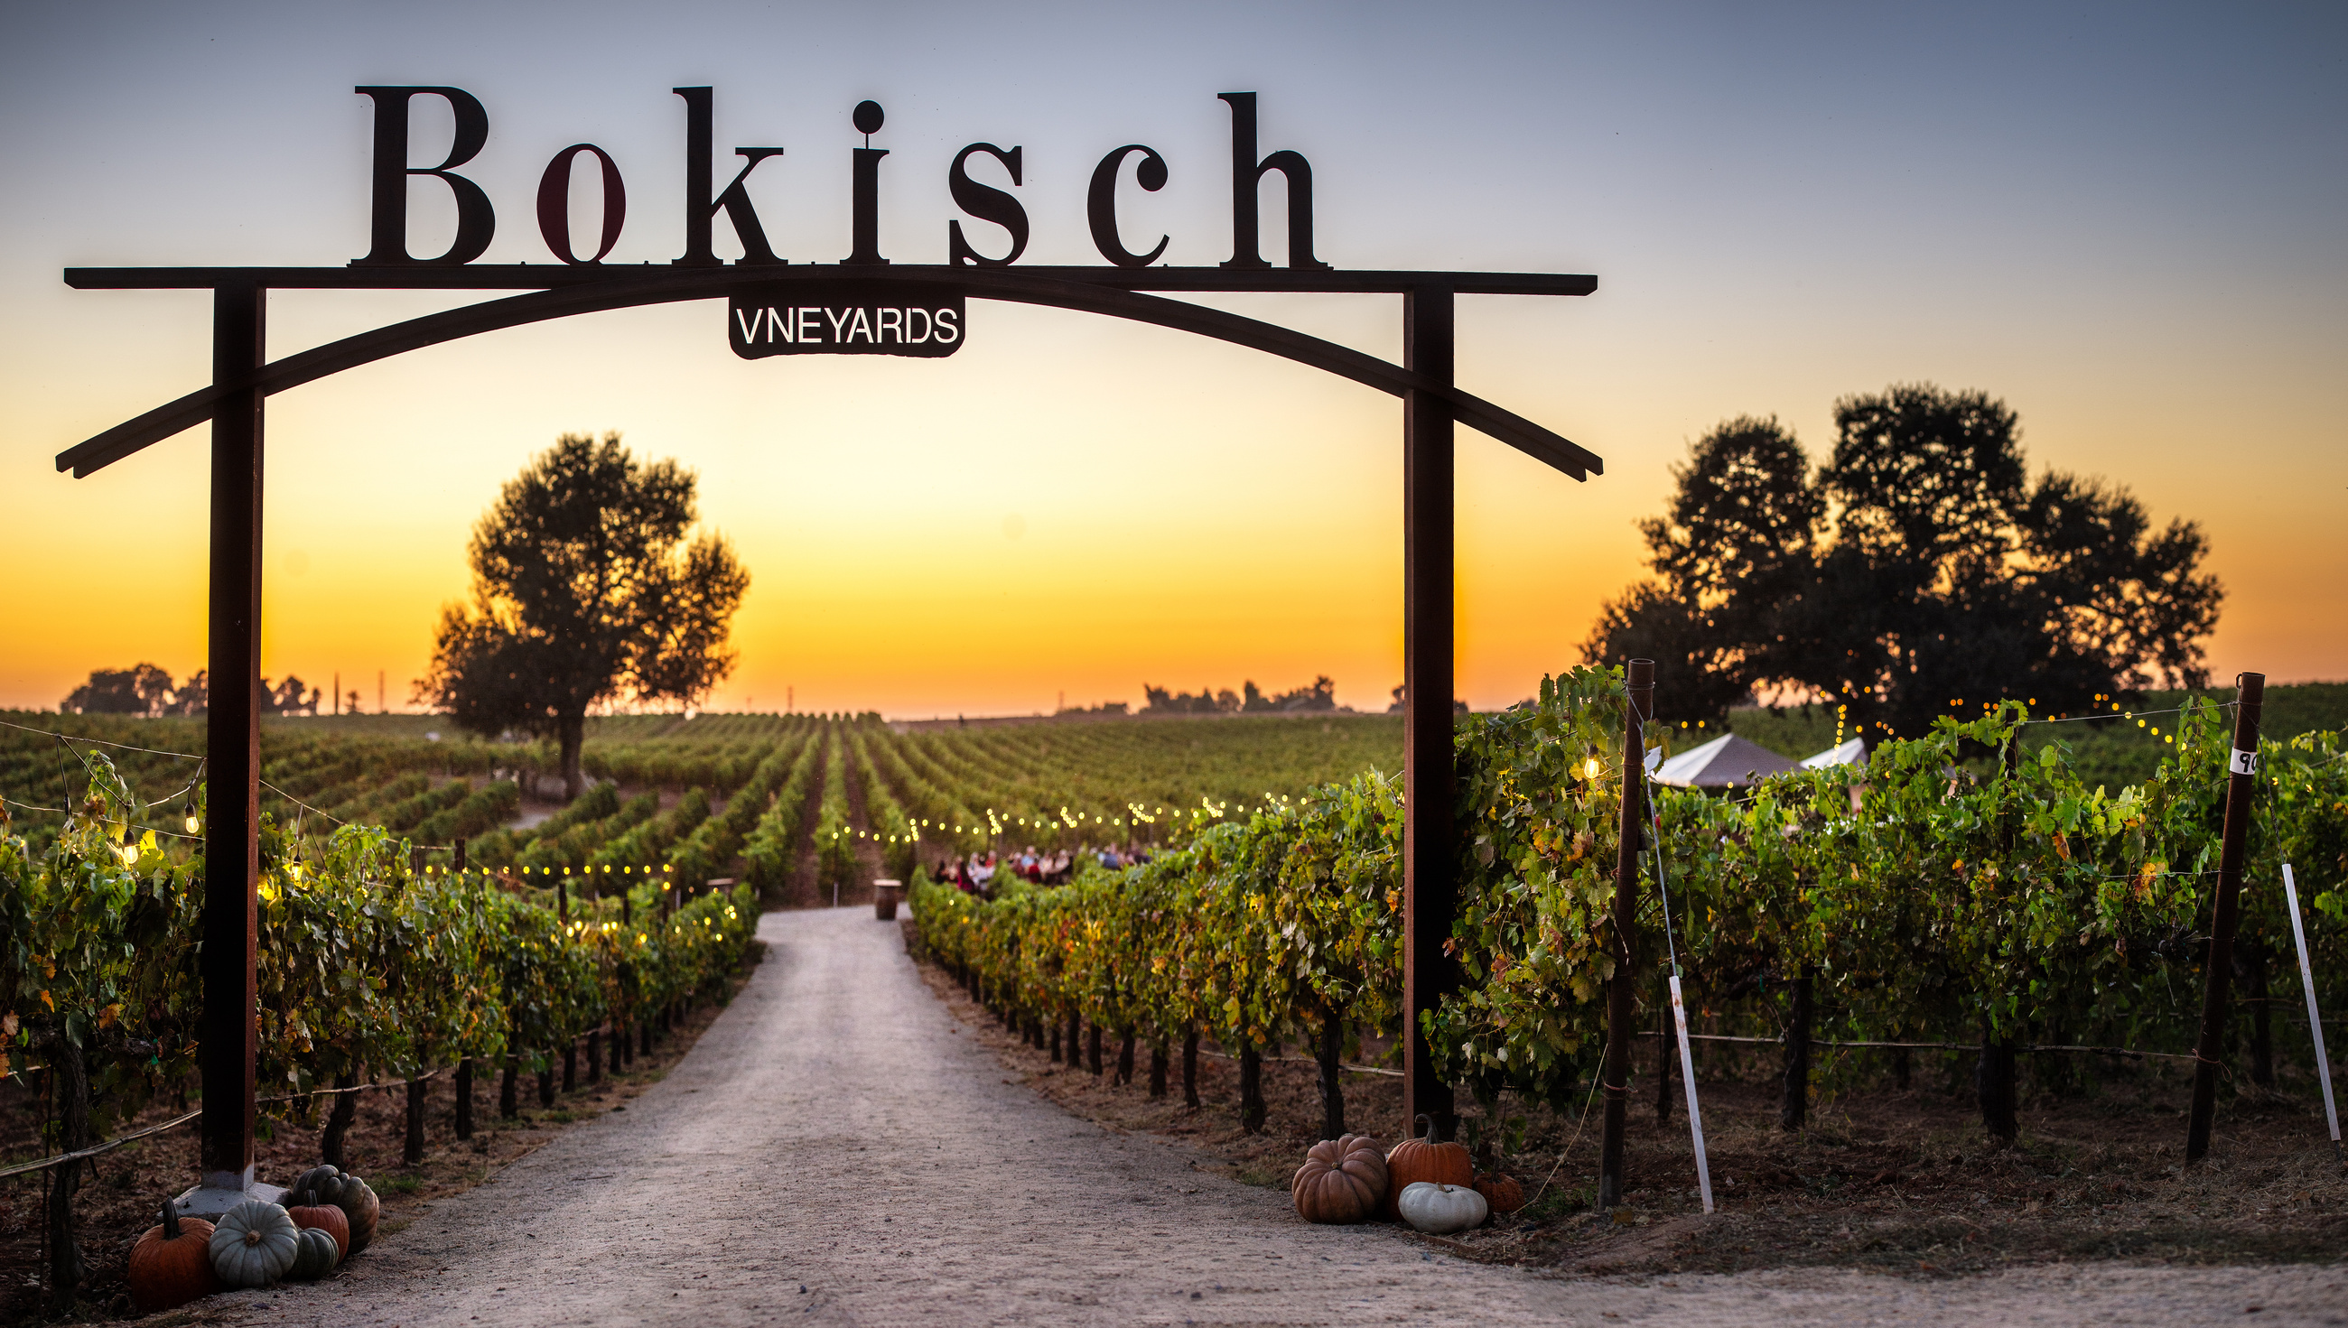

Slide 2
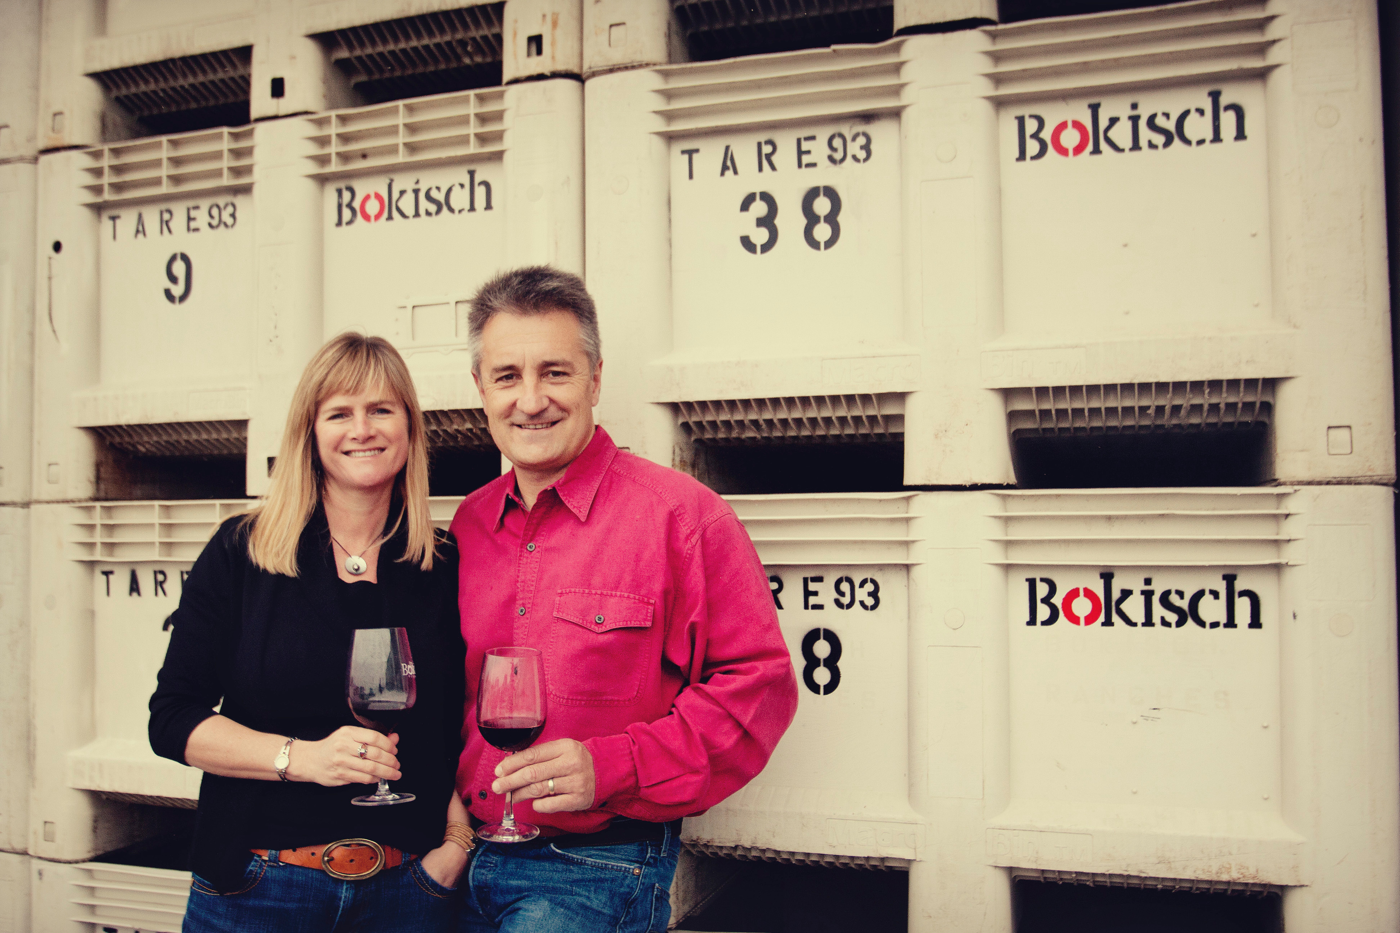
Our Journey

Slide 3
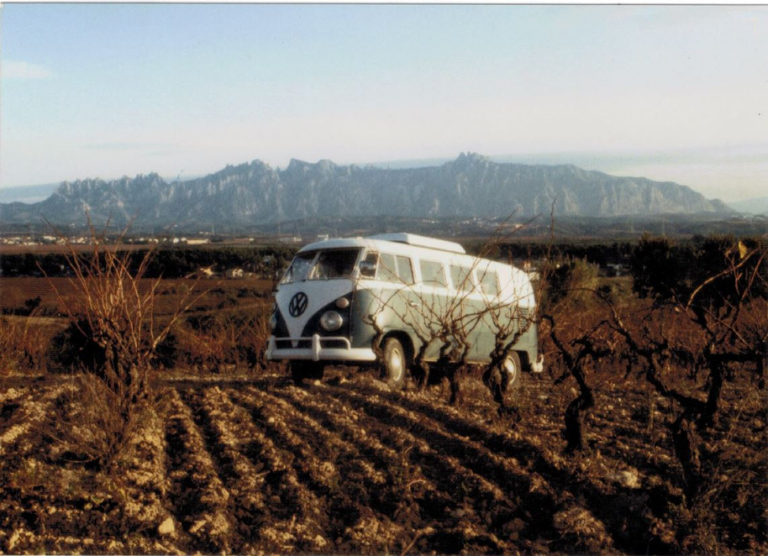
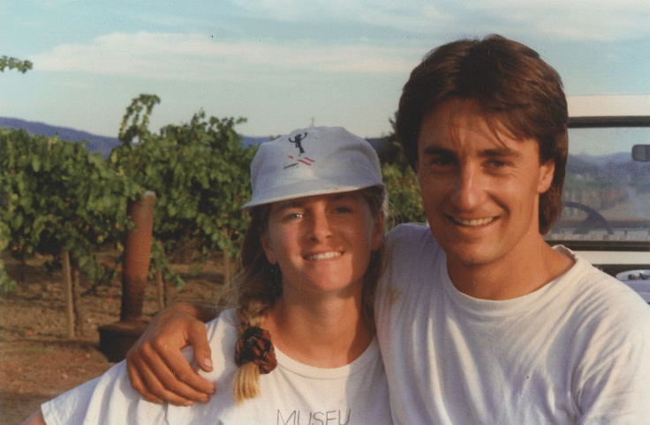


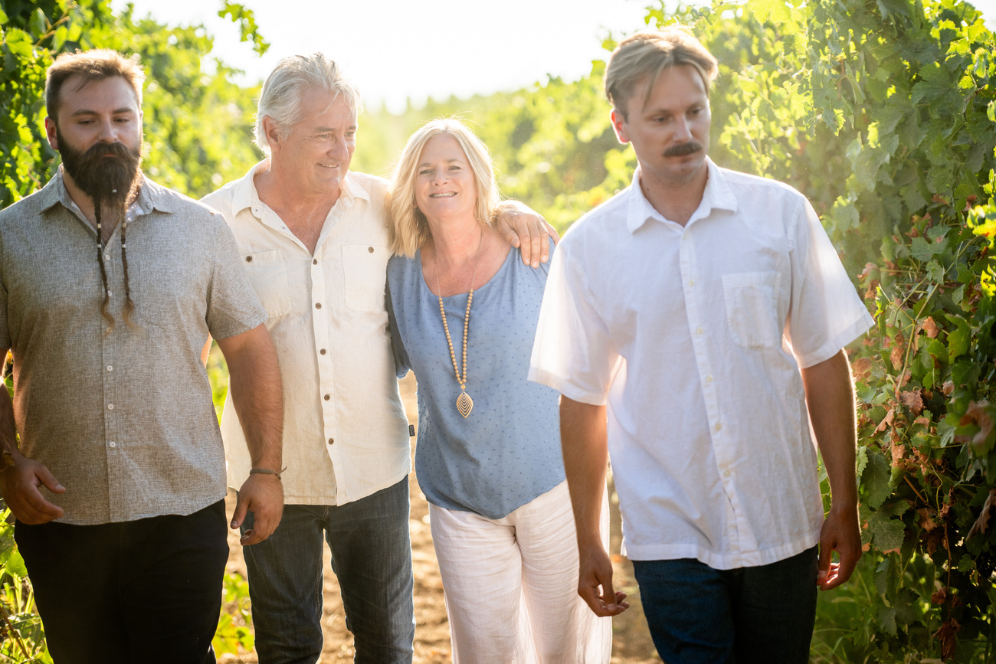

Slide 4
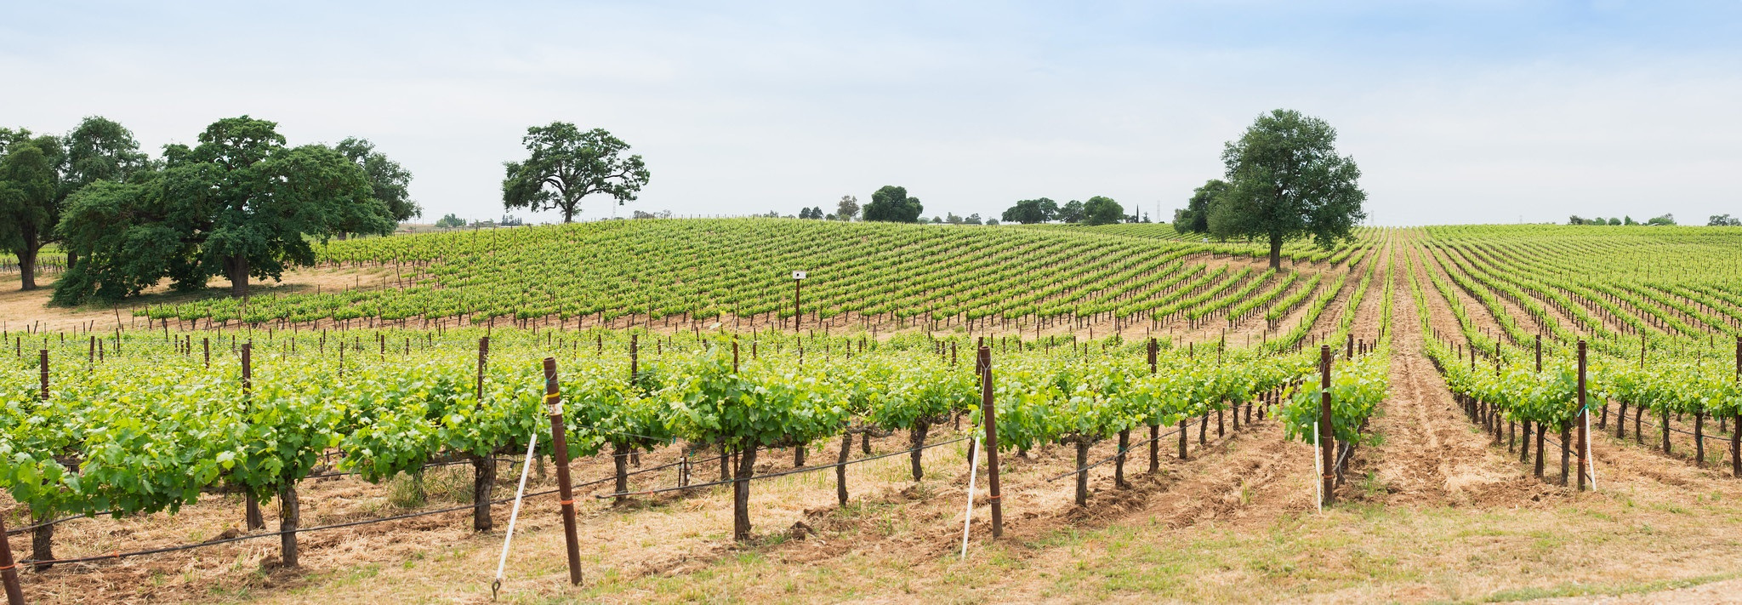
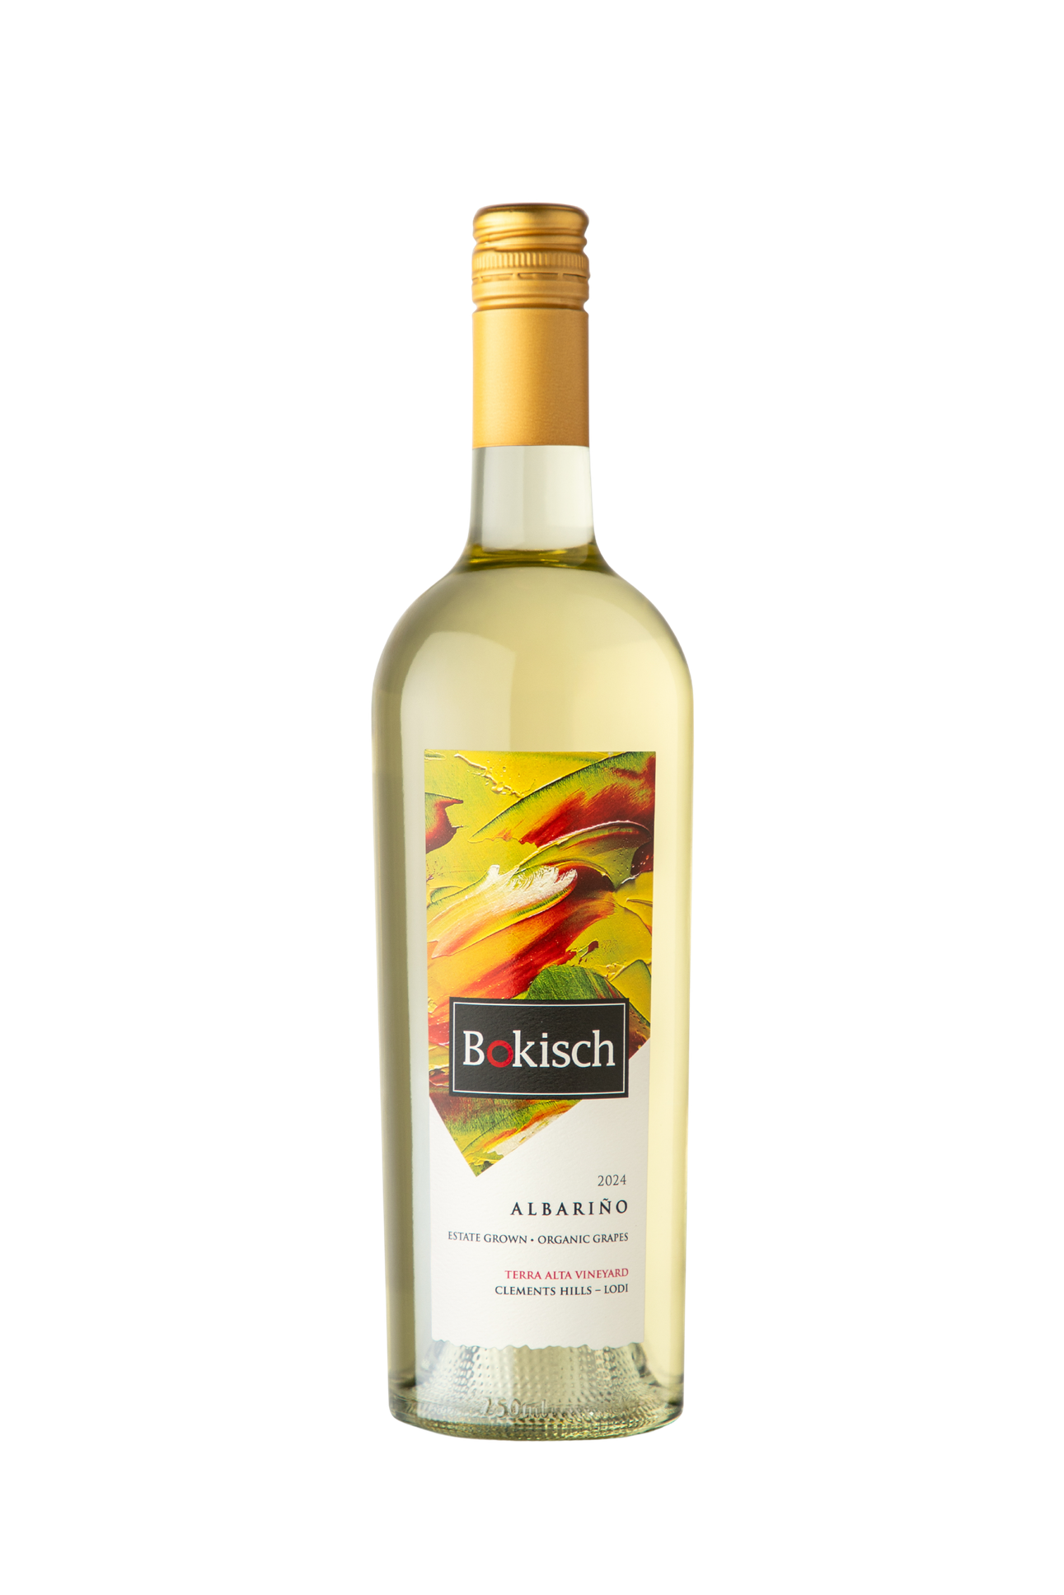
Albariño Terra Alta 2025
Our Most Popular White Wine
  Origin: Galicia, Spain
  Planted in Clements Hills AVA
  Second Oldest Albariño Vineyard in the New World
  Picked at low sugar levels for brilliant acidity
  Aged exclusively in stainless steel
  (750 cases produced)

Slide 5
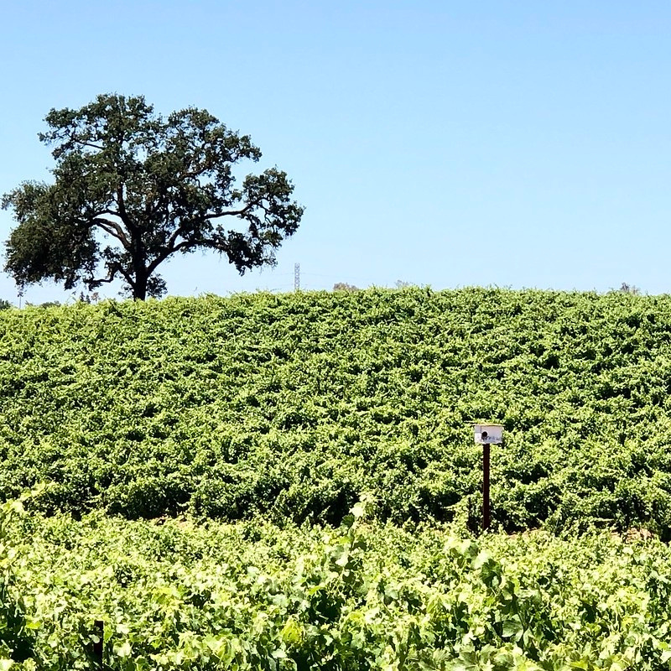
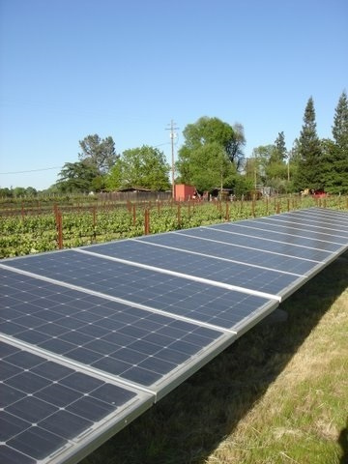
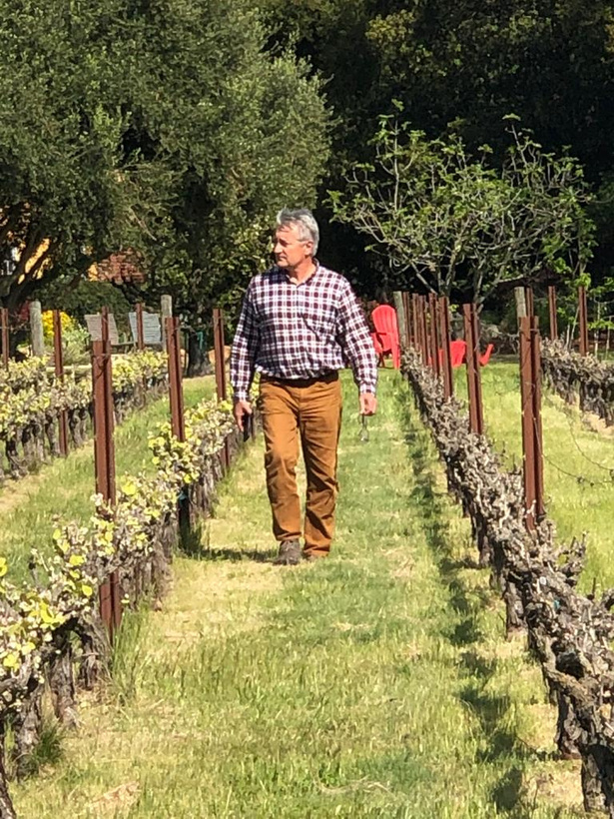



Sustainable Farming

Slide 6
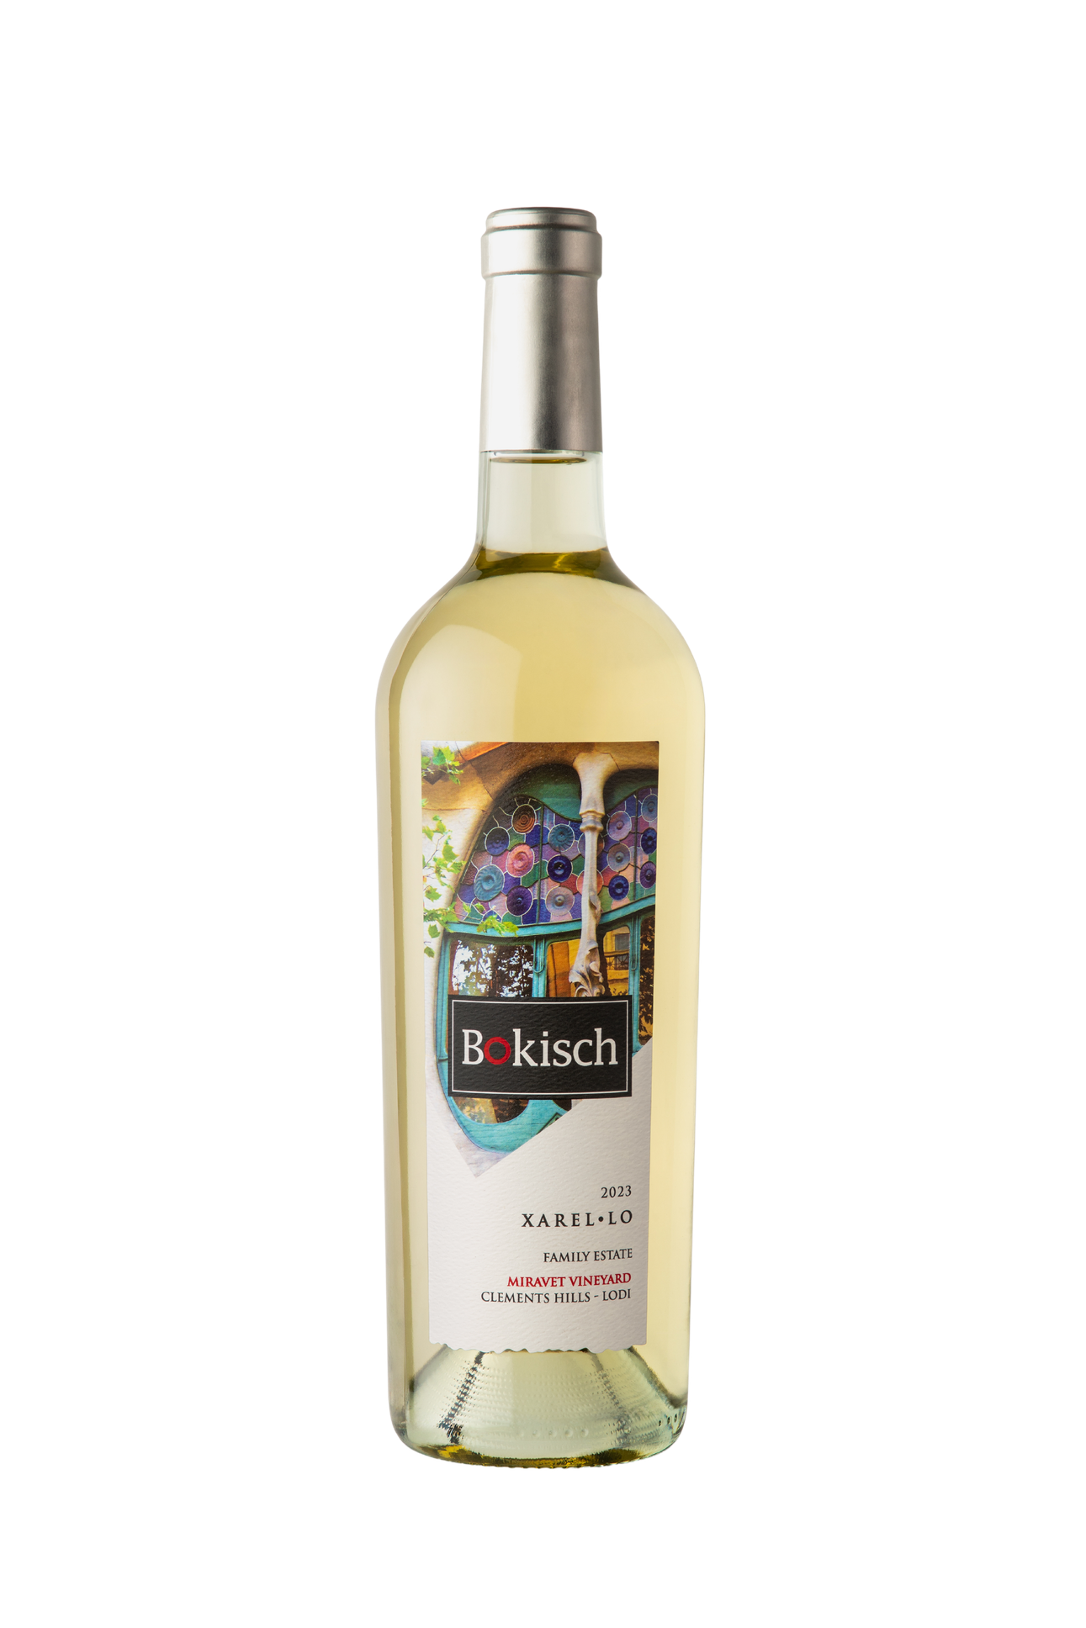
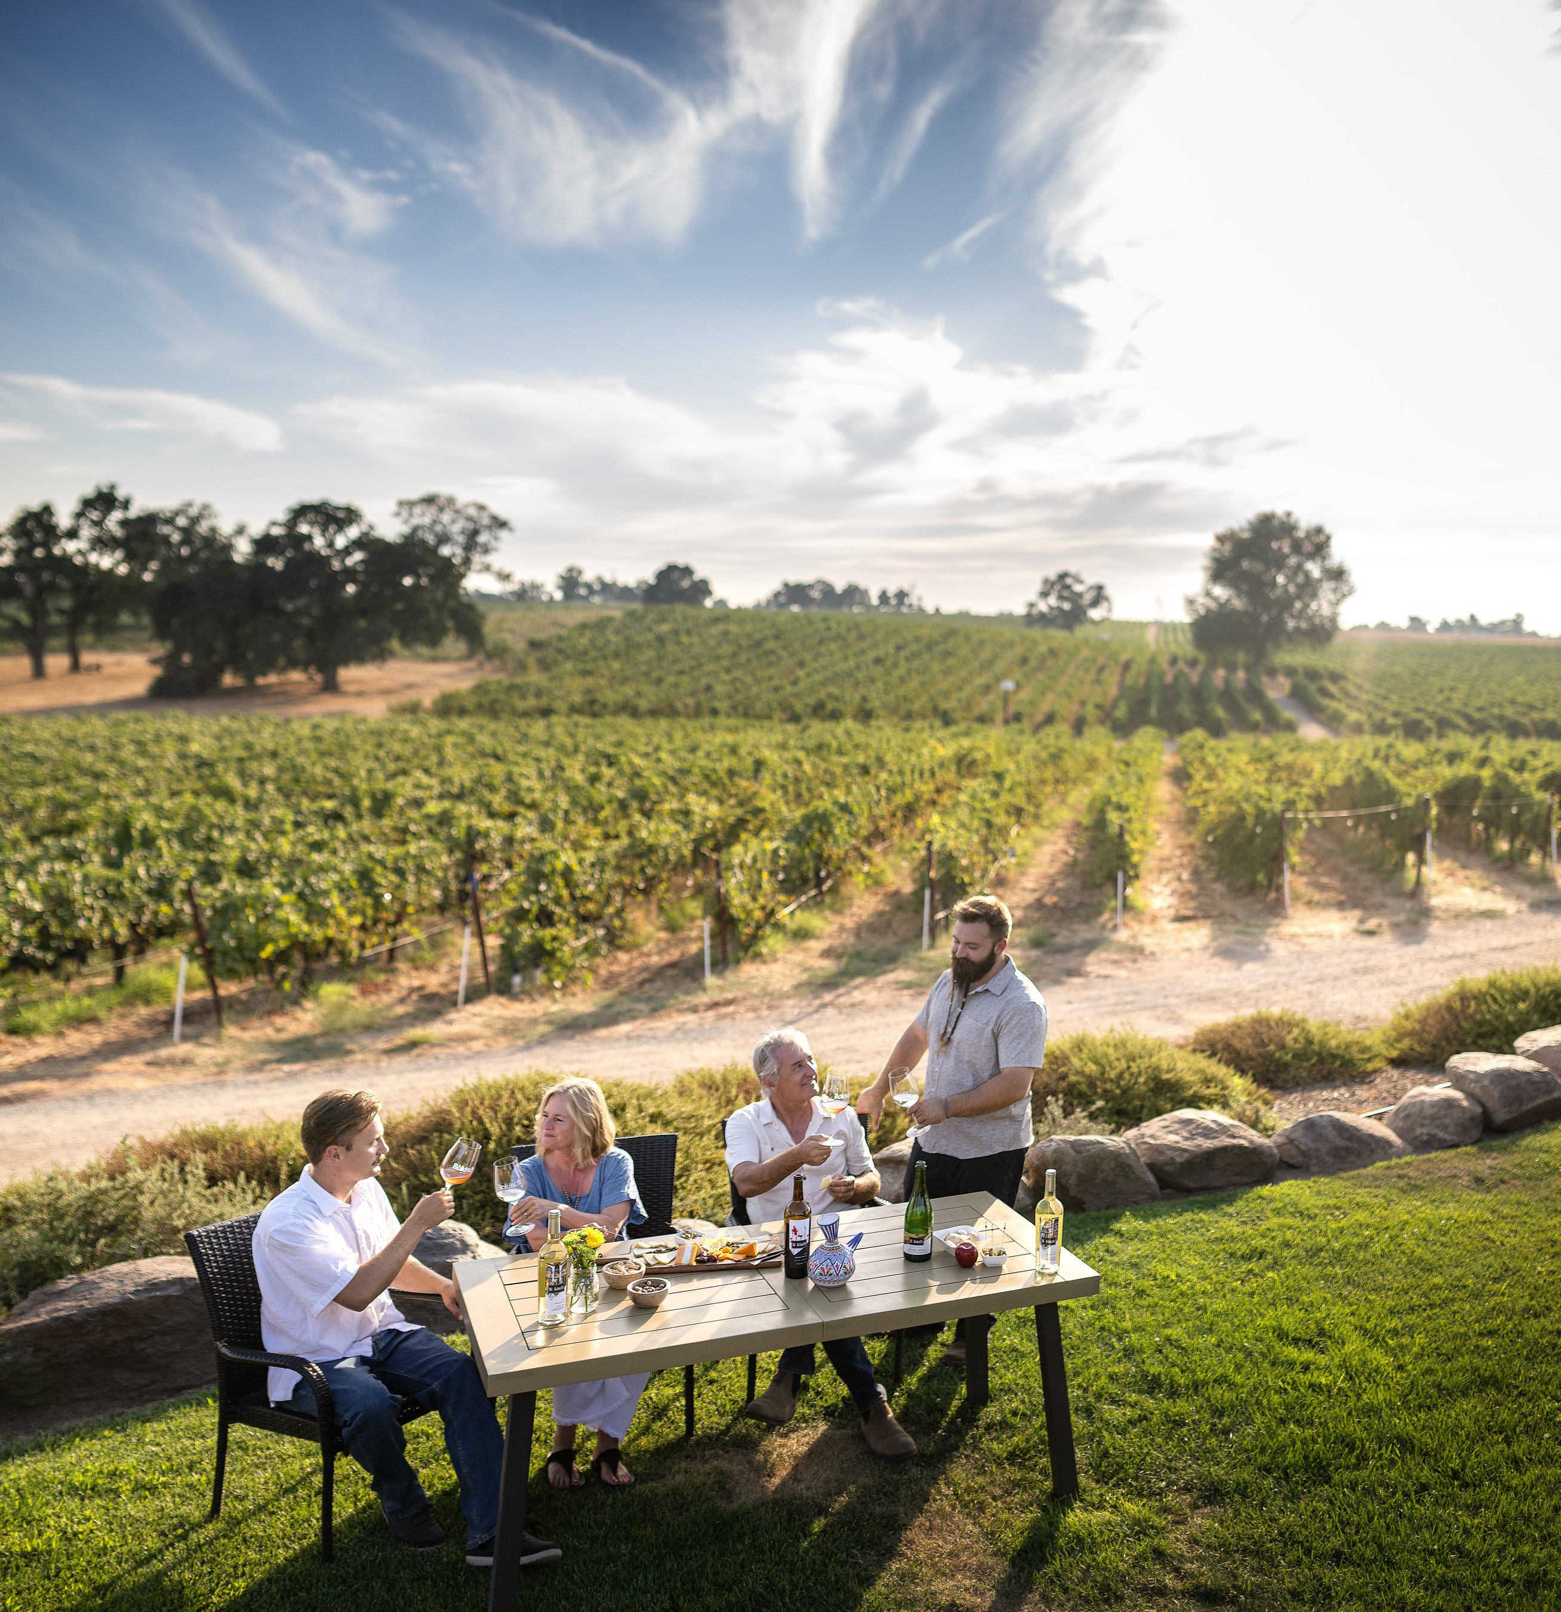
Xarel·lo 2024 – Miravet Vineyard
Structured Mediterranean White Wine
  Origin: Catalunya, Spain
  Planted in Clements Hills AVA
  Blending component for Spanish Sparkling wines (Cava!)
  Naturally high acidity
  Structured, high-acid white wine with excellent aging potential
  Aged exclusively in stainless steel
  (168 cases produced)

Slide 7
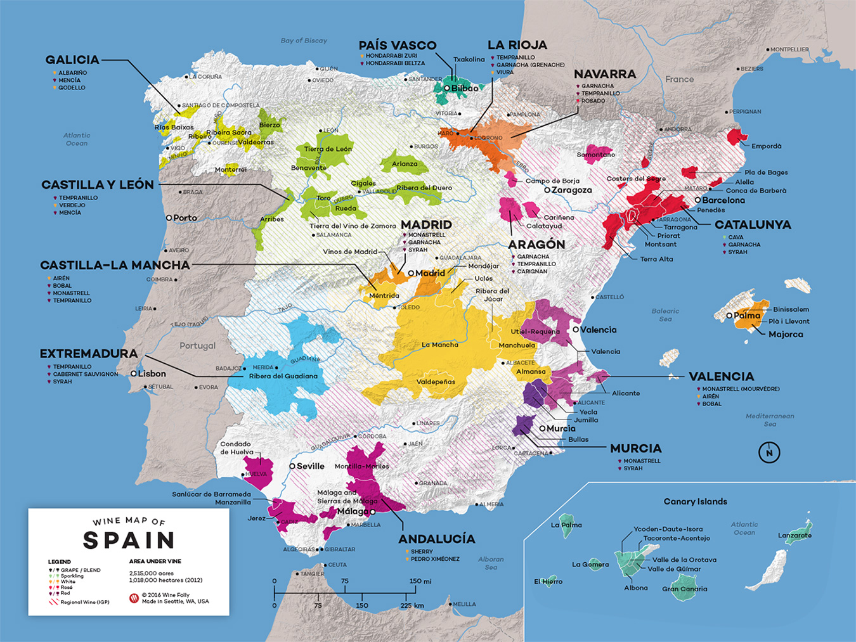

Slide 8
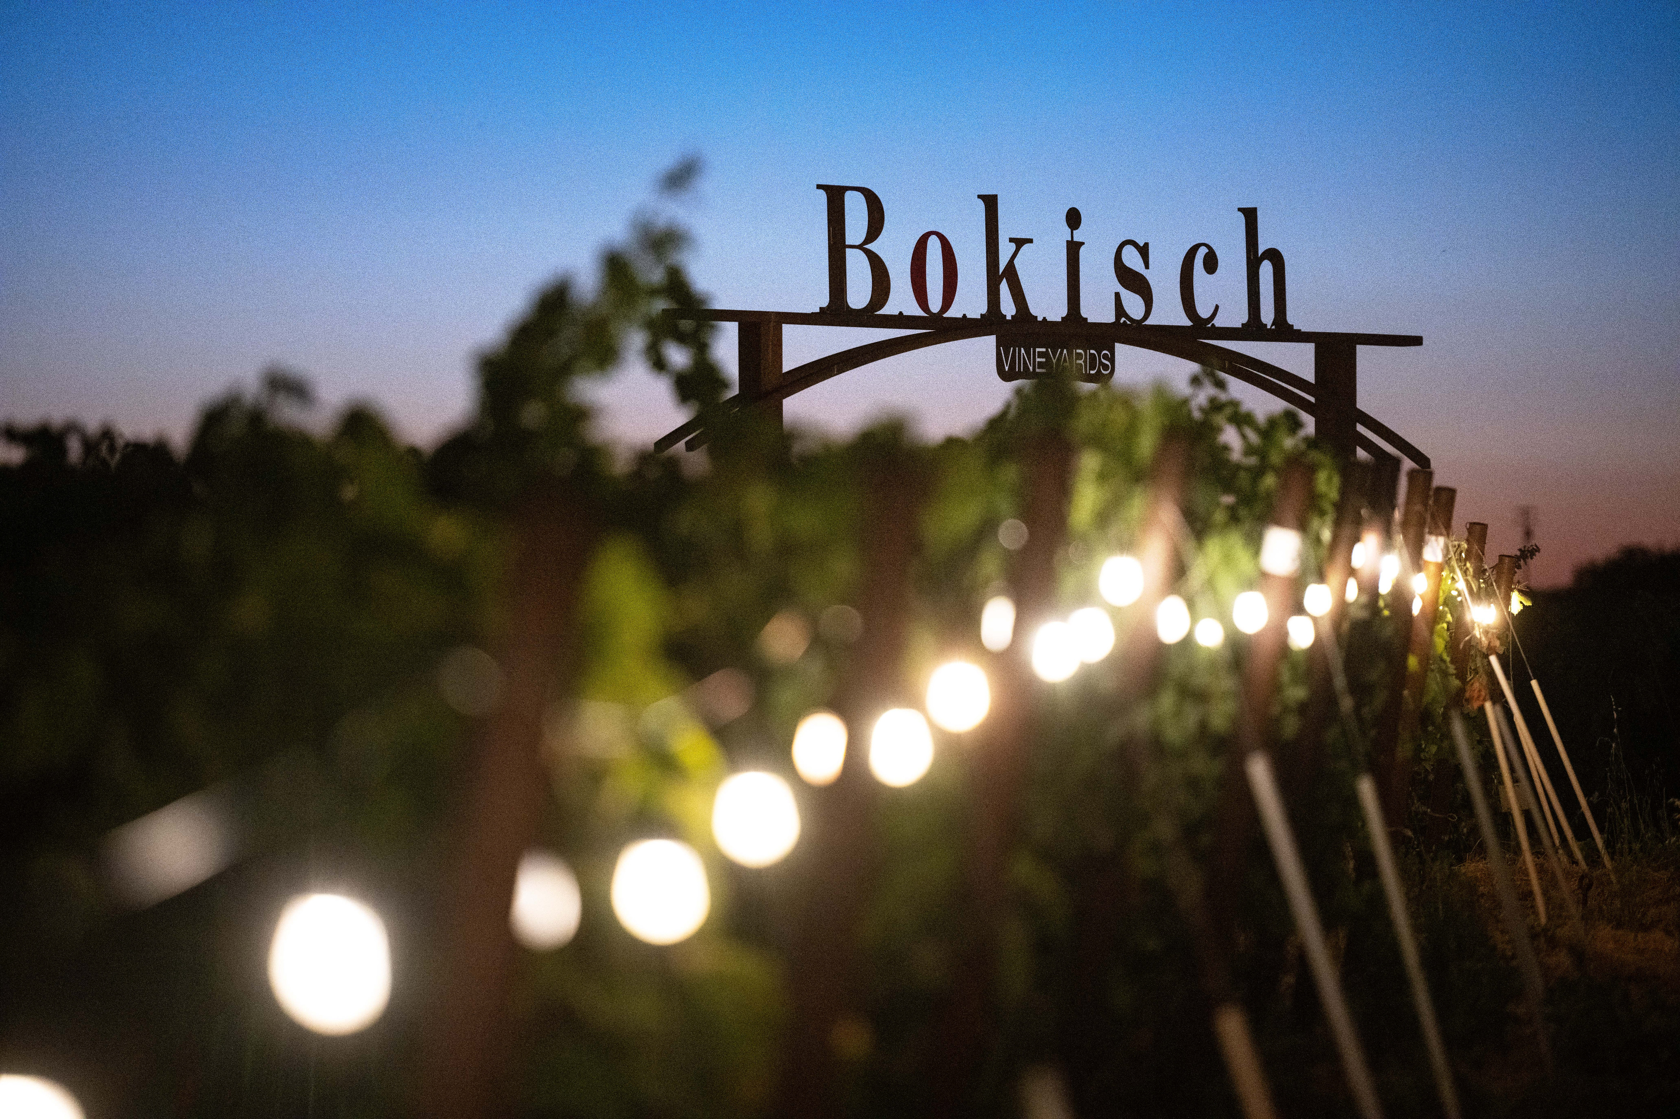
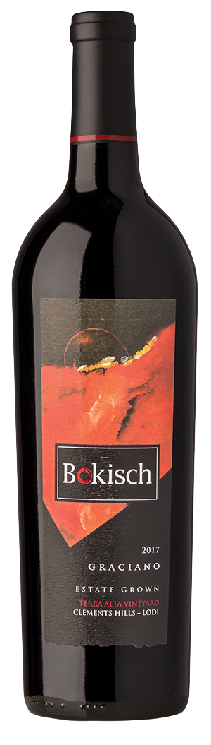
Graciano 2021 – Terra Alta Vineyard
Dark Spice Spanish Power
  Origin: Rioja, Spain
  Planted in Clements Hills AVA
  Typically blended with Tempranillo
  Intense aromatics (violet, spice, black fruit)
  Bokisch Vineyards was the first American winery to plant Graciano in the United States
  Excellent aging potential
  (168 cases produced)

Slide 9
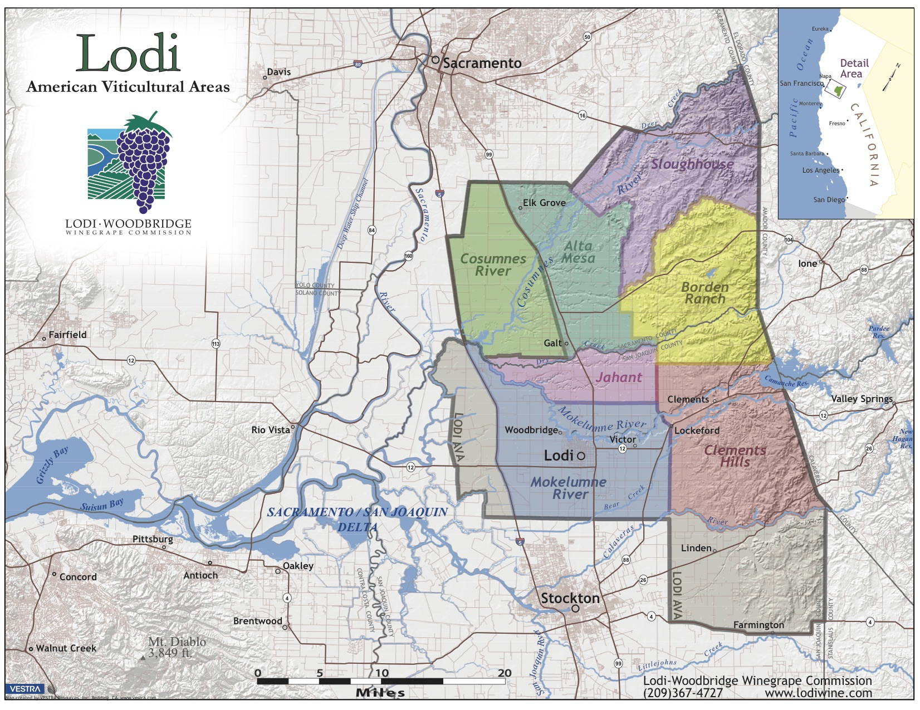

Slide 10
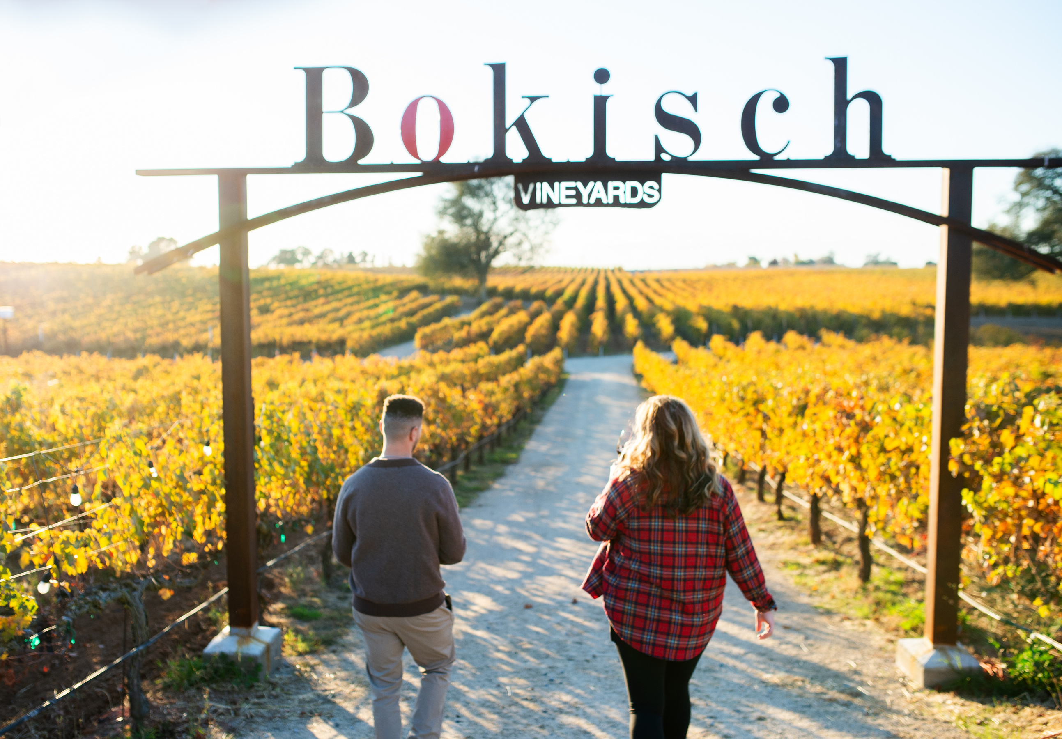
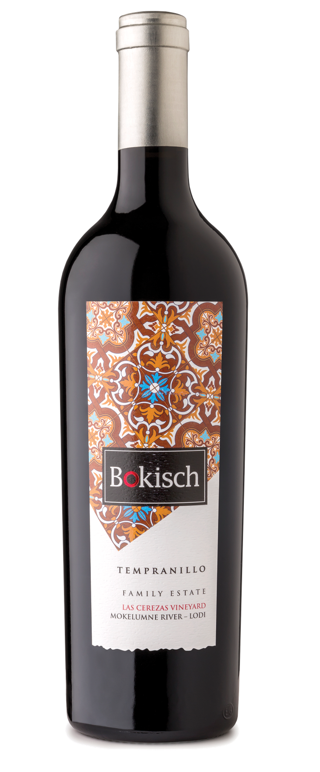
Tempranillo 2021 – Family Estate
Spain’s Legendary Noble Grape
  Origin: Rioja, Spain
  Planted in the Mokelumne River AVA
  Spain’s most important red grape
  Tobacco and leather
  Structured, age-worthy red wines with red fruit and savory complexity
  Excellent aging potential
  (168 cases produced)

Slide 11
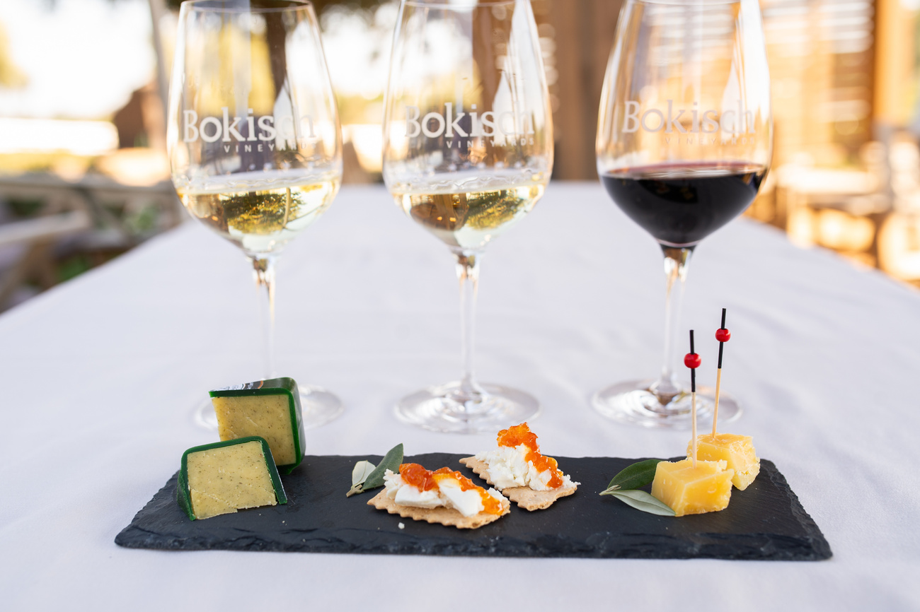
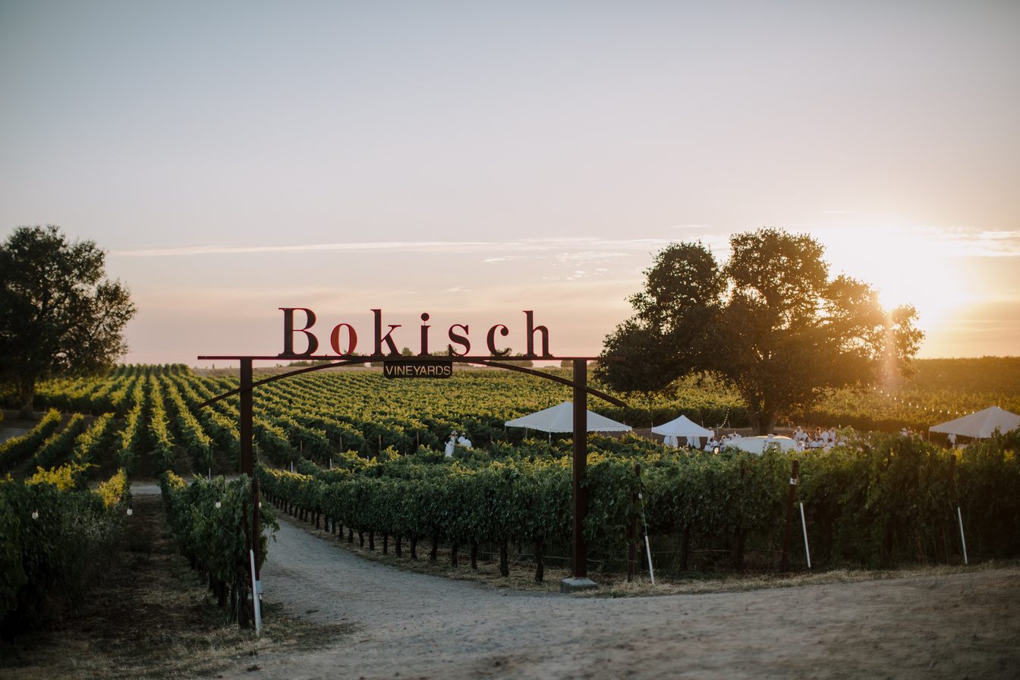
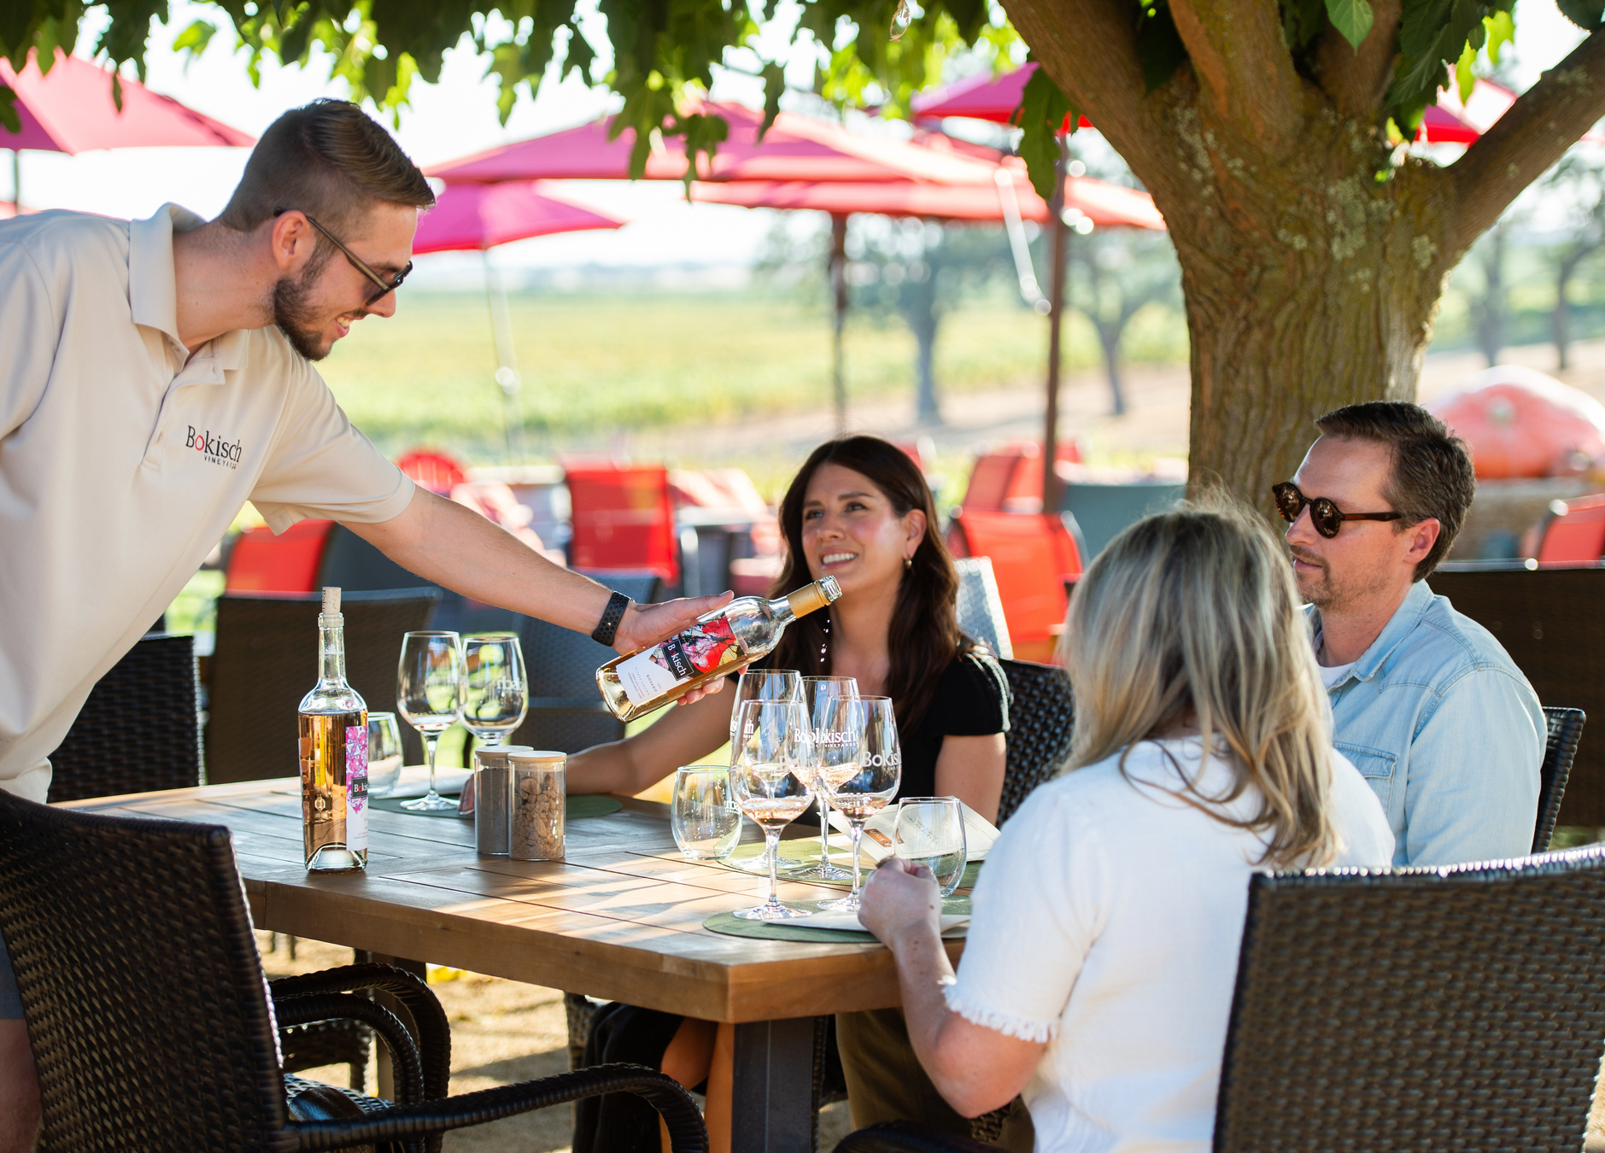



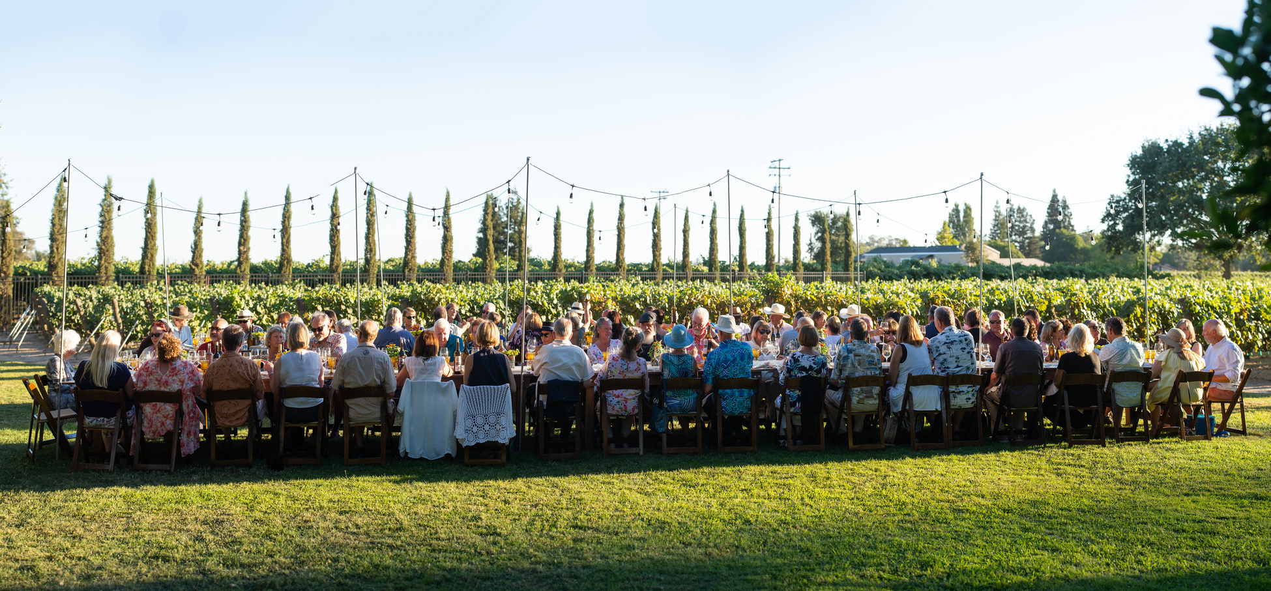
Visit Us!
Join us at our tasting room in Lodi!

Slide 12
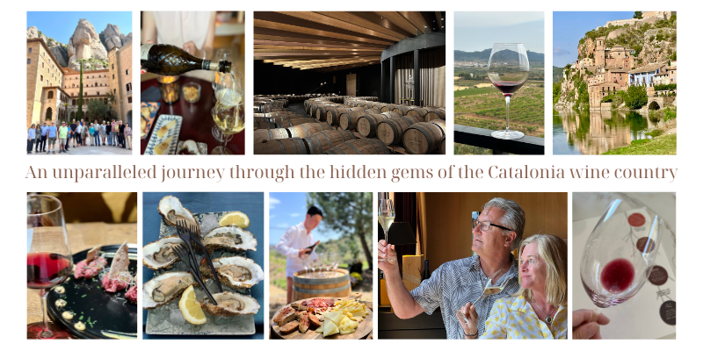
Wine Club Tours to Spain

