Slide 1
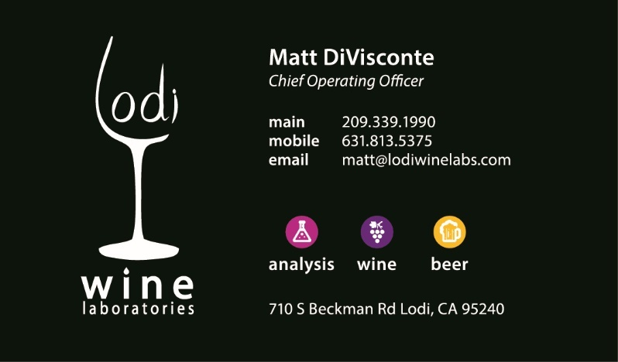
Organoleptic Compounds of Wine
AKA Things you can taste or feel

Slide 2
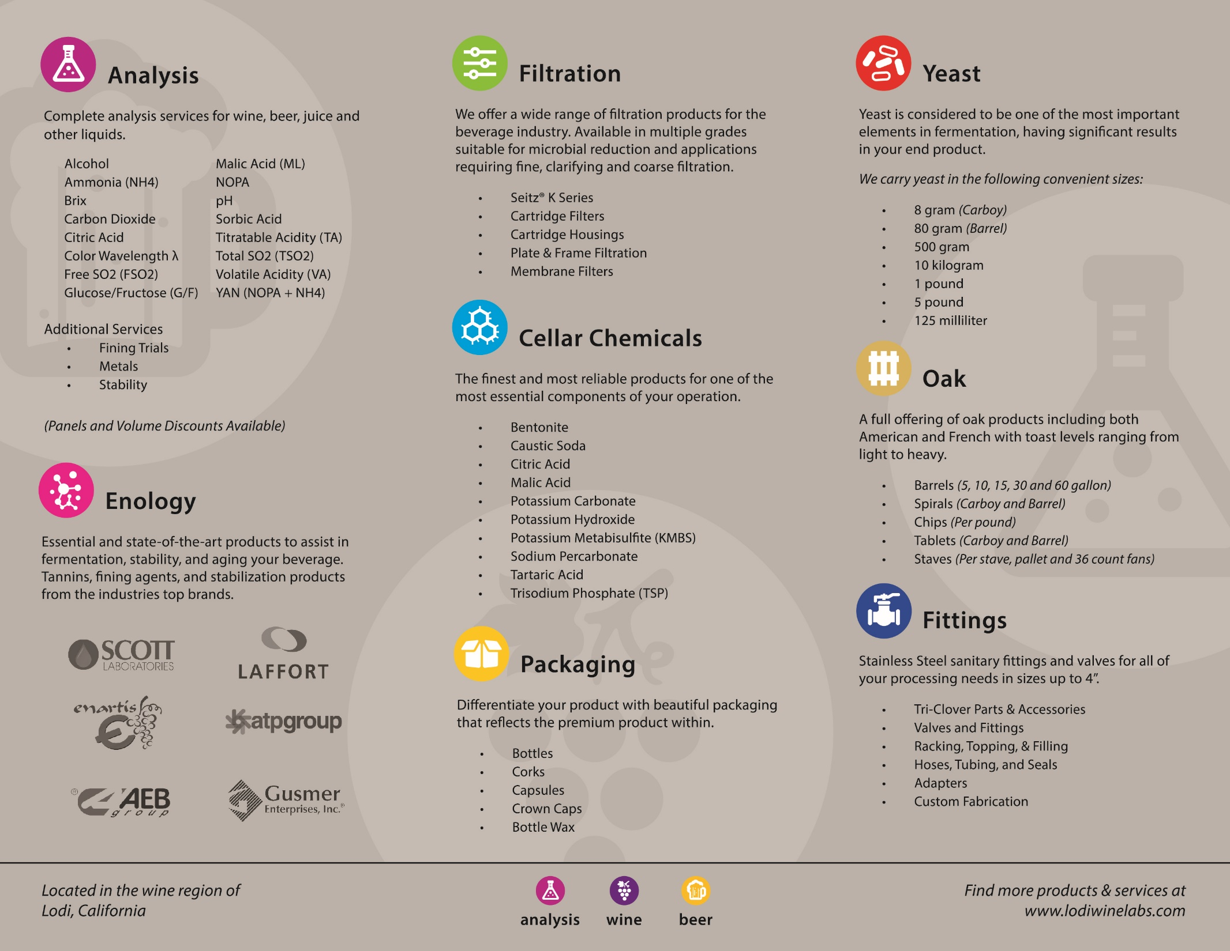

Slide 3
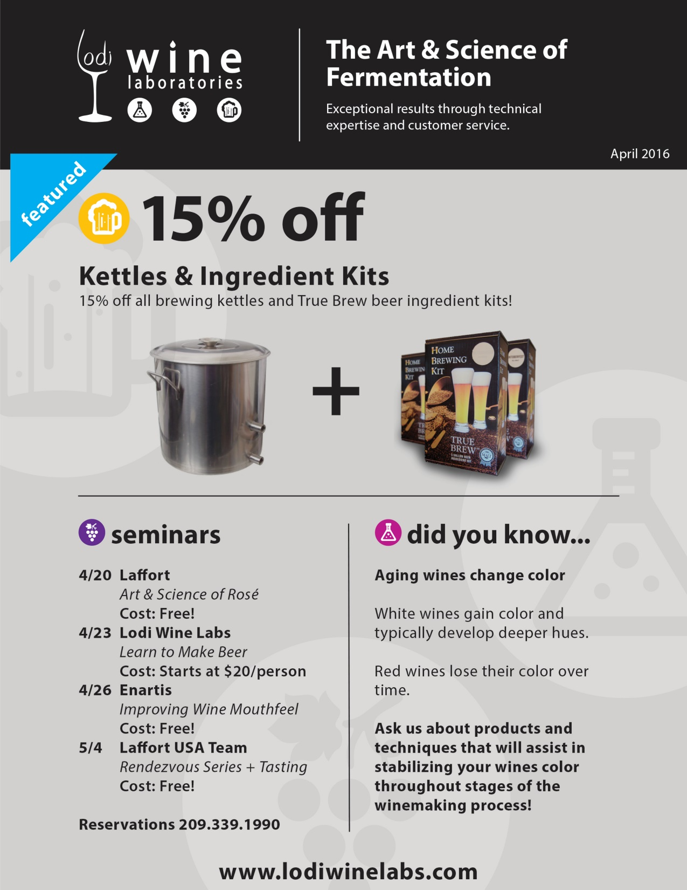


Slide 4
Organoleptic Compounds of Wine
GOALS
To detect, or learn to detect, small differences in various compounds that are commonly found in wine
I will give a little scientific background on these various substances
Discuss where they come from or why they are there
Then individually you will try to see if you can detect small increases in these compounds in the wines in front of you

Slide 5
Outline of compounds
Ethanol
Sucrose
Tartaric Acid
Tannin
Potassium Metabisufite (KMBS)
Acetic Acid + Ethyl Acetate
Hydrogen Peroxide
Alcohol
Residual Sugar
Acidity
Astringency/Bitterness
Sulfur Dioxide (SO2)
Volatile Acidity
Oxidation

Slide 6
ethanol
Depending on the yeast used, typical alcohol yields are around (Brix x 0.56)
Yeast don’t do this to get you drunk
Yeast do it to make energy for themselves

Slide 7
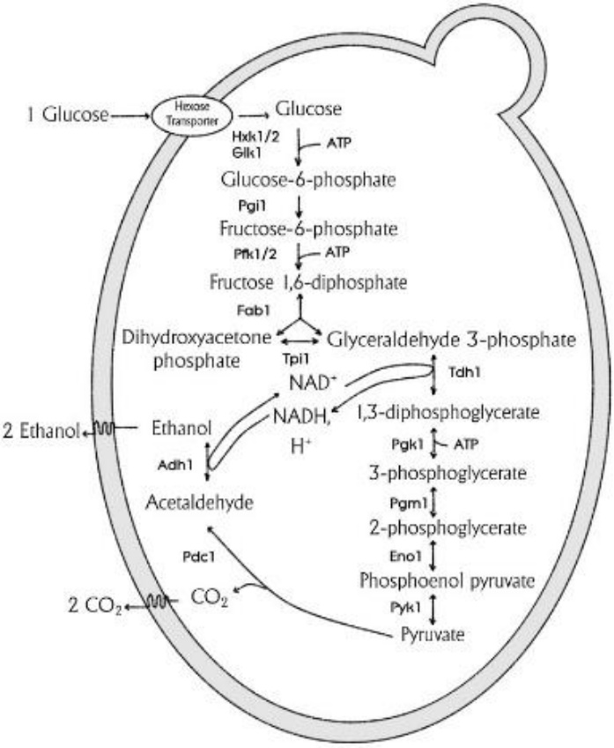
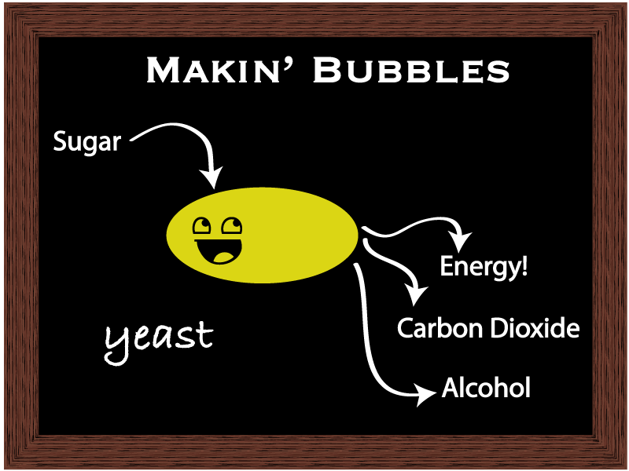

Alcoholic fermenation

Slide 8
alcohol
Contributes to Mouthfeel
Contributes to “Legs”
Can taste and feel “Hot”
Tends to make acidity and astringency more noticeable
Control has been spiked with Alcohol
Smell and taste the control wine
Smell and taste the spiked sample
Are they different? How?
Increase of 0.6%

Slide 9
Residual sugar

Slide 10
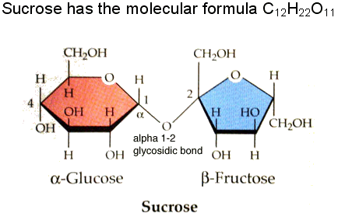
Sugar
Predominate sugar in grapes is Sucrose
In acidic environments (i.e. wine) it breaks
down into Glucose and Fructose
Both of these are fermentable by yeast
But yeast think Glucose is yummier
  Since they are lazy and it requires extra steps to ferment Fructose

Slide 11
Residual sugar
Threshold for detection for sweet is around 5 g/L (0.5%)
At sub threshold concentrations it can add body and change the aroma profile of wines
Can be masked by acidity. (Balanced?)
Control sample has been spiked with Sucrose
Smell and taste the control wine
Smell and taste the spiked sample
Are they different? How?
Increase of Residual Sugar by 8 g/L (or 0.8%)

Slide 12
acidity

Slide 13
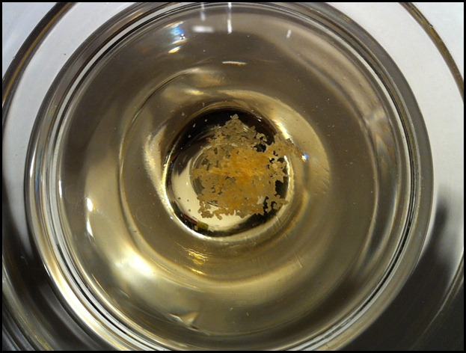
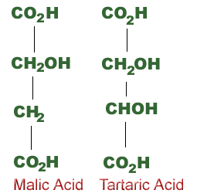
Acids

Slide 14
Acids found in grapes
ACID | COMMENTS
Tartaric and tartrates: H₂T KHT K₂T | Occurs naturally in grapes Strongest of natural acids
Malic Acid H₂M | Occurs naturally in grapes Declines post-verasion
Citric Acid H₃C | Occurs naturally but at very low levels

Slide 15
Acids in Wine
ACID | COMMENTS
Tartaric and tartrates: H₂T, KHT | Added to acidify juice Some lost during vinification
Malic Acid, H₂M | Can be added to acidify wine Can be formed by yeast Lost by MLF
Citric Acid, H₃C | Occurs naturally at very low levels Do not add to juice/wine for export
Lactic Acid, HL | Arises during MLF Minor yeast product
Acetic Acid, HOAc | Produced by all yeast and some bacteria
Succinic, Pyruvic Acids | Very small amounts during fermentation
Ascorbic Acid | Added as an antioxidant
Carbonic Acid | CO₂ in Wine
Sulfurous Acid | SO₂ in Wine

Slide 16
Importance of achieving acidic conditions in juice and wine
Inhibition of microbial spoilage
Increase antimicrobial action of SO2
Increase color expression in young red wines
Selection of desirable microorganisms
Enhanced clarification of juices and wines
Enhanced expression of fruit character
Promote balance of wine and ageing potential

Slide 17
Acidity terms
pH – the equilibrium measure of hydrogen ion concentration in a juice or wine
Titratable acidity – a measure of the total exchangeable protons in a juice or wine
Buffer capacity – the property of a juice or wine to resist changes in pH as the acid or alkali composition changes
Total acidity – a measure of the total organic acids present in a juice or wine

Slide 18
Titratable acidity
The acid taste of wine comes from the undissociated acids rather than hydrogen ions
Boulton “The titratable acidity has no known effect on chemical or enzymatic reactions or microbial activity and is of primary importance only to the sensory perception of finished wines”

Slide 19
Acid Adjustment
Acidification
  Most common is the addition of tartaric acid
    Malic? (MLF problems)
    Citric? (export and yeast problems)
Deacidification
  Removal of acid by MLF
  Precipitation of KHT during vinification
  Addition of potassium carbonate
K₂CO₃ + 2H₂T
2KHT + CO₂

Slide 20
Deacidification via MLF
Malolactic Fermentation
  Bacterial conversion of malic acid to lactic acid (a weaker acid)
  A decarboxylation reaction (CO₂ is lost)
  Results in an increase in pH of the wine and a decrease in its TA

Slide 21
Acid Management
Good Management
Poor Management
Microbial stability
Effective (legal) use of SO₂
Optimal fermentations
Reduced oxidation
Better color expression
Enhanced ageing potential
Growth of spoilage microbes
Ineffective SO₂ use
Poor color and palate
Short-lived
Poor fermentation control

Slide 22
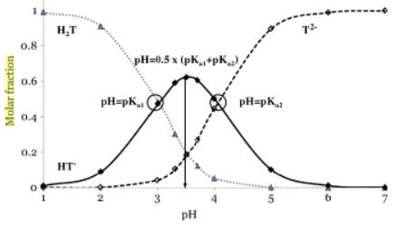
Tartaric Acid Equilibria
The Magic of pH 3.56/3.67
pKa=2.90
pKa=3.94
H₂T + H₂0
H⁺ + HT⁻
H₃0⁺ + T²⁻
Predominant
Form
HT⁻
pH = 3.56 (juice)
pH = 3.67 (wine)

Slide 23
White Magic of pH 3.56/3.67
Below pH 3.56/3.67 the predominant equilibrium is between:
Precipitation of KHT causes:
  A decrease in TA due to loss of a titratable proton
  pH decrease due to equilibrium shift to the right, producing more H⁺ (H₃O⁺)
H₂T + H₂O
H₃O⁺ + HT⁻
HT⁻ + K⁺
KHT (Potassium bitartrate)

Slide 24
Black Magic of pH 3.56/3.67
Above pH 3.56/3.67 the predominant equilibrium is between:
Precipitation of KHT causes:
  A decrease in TA due to loss of a titratable proton
  pH increases due to equilibrium shift to the left, removing H⁺ (H₃O⁺) from the solution
H₂O⁺ + HT⁻
T²⁻ + H₃O⁺
HT⁻ + K⁺
KHT (Potassium bitartrate)

Slide 25
Equivalent Mass
How much does TA change if other acids are added?
  The equivalent mass of an acid is calculated from its molecular mass divided by the number of ionizable protons
    Tartaric, mass=150, 2 protons, equivalent mass is 75
    Malic, mass = 134, 2 protons, equivalent mass is 67
The effect on the pH of the solution is dependent on the strength of the acid added
HA
H⁺ + A⁻

Slide 26
Buffers and buffer capacity
The property of a juice, must or wine to resist changes in pH
It is a function of the composition of the sample
  Related to the concentration of the acids in the sample and the proximity of the pH of the sample to their pK_{a}’s
  pKa = pH point where equilibrium between the undissociated acid (HA) and anion (A-) is achieved

Slide 27
Total acidity
An analytical measure of the total organic acid species in a solution
Cannot be determined by titration
Not to be confused with “titratable acidity”
  However, many people use these terms interchangeably

Slide 28
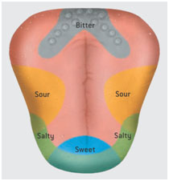
acidity
Acidity is perceived on the sides of the tongue and has a sharp/tingly sensation
Wines with a low level of acidity are frequently described as “flabby”
Control sample has been spiked with Tartaric Acid
Smell and taste the control wine
Smell and taste the spiked sample
Are they different? How?
Increase of Titratable Acidity by 1 g/L

Slide 29
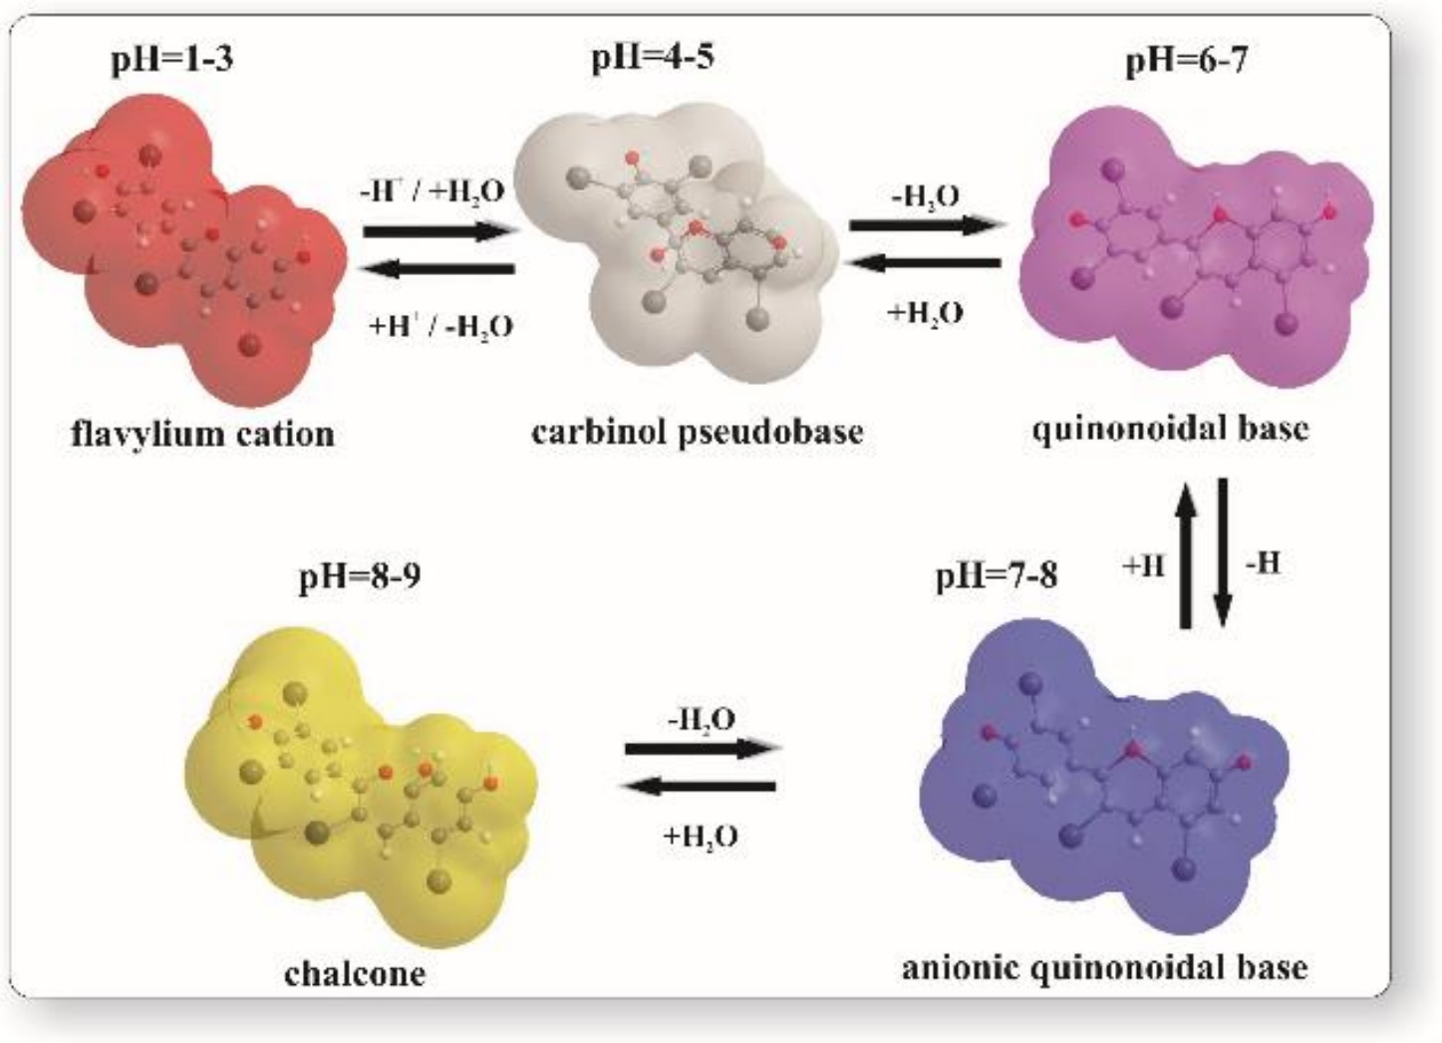
tannin
Tannins are plant polyphenols
Bitter and Astringency
Color

Slide 30
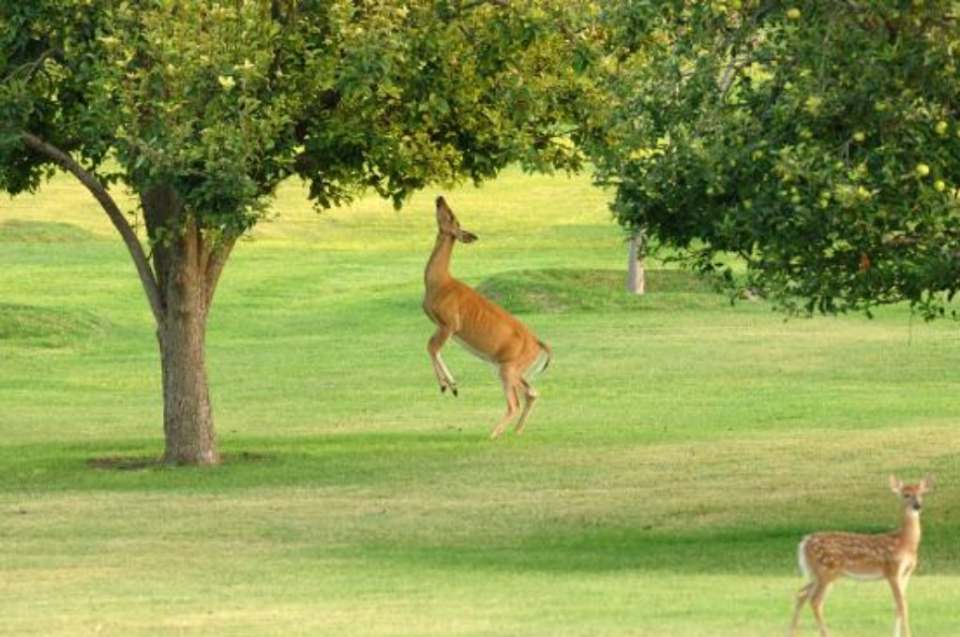
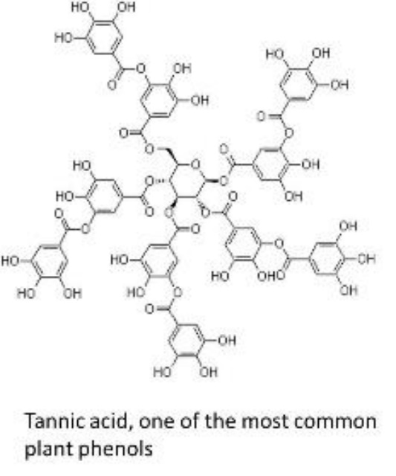
Tannins
Found in legumes, berries, grapes, grains, nuts, tea, fruit juices and wine
Plant defense mechanism again microbial attack and herbivore predation
Thousands are known to exist

Slide 31
Tannins
Tannins are complex class of polyphenols
  Hydrolysable Tannins – oak derived
  Condensed Tannins – important for grapes
Tannins bind to and precipitate proteins
Tannins are used in the tanning of hide to make leather
Deleterious Effects
  Inhibit digestive enzymes
  Decrease body weight gain/growth

Slide 32
Why are phenolics important for wine
Organoleptic considerations
Largely grape derived
Targets of oxidase activity in juice/must
Ageing of wine is linked to phenolic composition
Precursors for microbial spoilage - Brett
Health benefits – resveratrol
Wine color

Slide 33
Grape Phenolics – Total phenol levels in Vitis vinifera grapes
COMPONENT | RED GRAPES | WHITE GRAPES
Skin | 1859 | 904
Pulp | 41 | 35
Juice | 206 | 176
Seeds | 3525 | 2778
TOTAL | 5631 | 3893
Numbers is Gallic Acid Equivalents (mg/kg GAE)

Slide 34
Wine Phenolics
COMPONENT | RED WINE | WHITE WINE
Non-flavonoids | 200 | 42.5
Anthocyanins | 150 | ---
Condensed Tannins | 750 | 60
Other Flavanoids | 250 | 10
Flavonols | 50 | 0.2
TOTAL | 1400 (5631) | 112.7 (3893)

Slide 35
Astringency and Wine
Essential Attribute for Wine
  Body or palate weight
  Contributes to flavor
  Adds complexity
  Lengthens perception of flavor
  Driver of quality
    Too high: difficult to drink
    Too low: boring

Slide 36
Astringency – Definition
“the complex of sensations due to shrinking, drawing or puckering of the epithelium as a result to exposure to substances such as alums or tannins”
  -- ASTM (1989)
Perceived differently by individuals

Slide 37
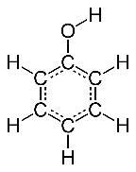
Astringent Substances in Wine
Phenols
  Primary source of astringency and bitterness in wine
  Yield color, body and flavor
  Cyclic benzene compounds with 1 of more OH groups
Phenolic Types
  Flavonoids
  Non-flavonoids

Slide 38
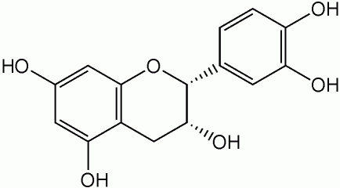
Astringent Substances in Wine
Flavonoids
  Most Important: ~85% of total phenolics in red wine
  Found in Skins, Seeds, Stems
  Most common in wine are: Flavonols, Catechins, Anthocyanins, Leucoanthocyanins
  Two Phenols joined by a pyran (O2 containing) ring
  Polymers = Condensed Tannins (Proanthocyanidins)

Slide 39
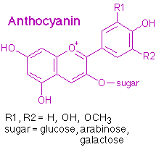

Astringent Substances in Wine
Flavonols – Skin, glycosidic form
Anthocyanins – Skin, color
Flavan-3-ols – Seeds, Stems
Catechin (Flavan-3-ol)

Slide 40
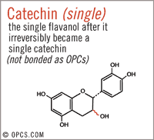
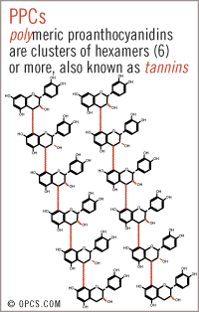
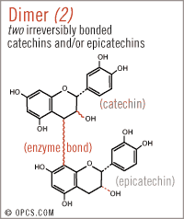
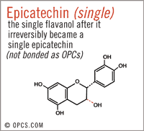
Astringency and Polymerization
AKA: Condensed Tannin
Bitter
Bitter & Astringent
Astringent
Tasteless
Monomeric
Polymeric

Slide 41
Astringency – How?
Still debated
  Widest belief is that the monomeric compounds bind to the bitter taste receptors and activate them
  While astringency is caused the tannins binding to saliva proteins (drying) and to the cell membrane surfaces of the mouth (drying/puckering)
  This effect is not noticed when food is eaten or is noticed less
    Due to the tannins binding to the food proteins instead of your proteins

Slide 42
Astringency/Bitterness
Contributes to body or palate weight
Contributes to flavor
Drying/Puckering
Control sample has been spiked with Tannin
Smell and taste the control wine
Smell and taste the spiked sample
Are they different? How?
Increase of tannins by 0.4 g/L (400 ppm)

Slide 43
Sulfur dioxide (SO2)

Slide 44
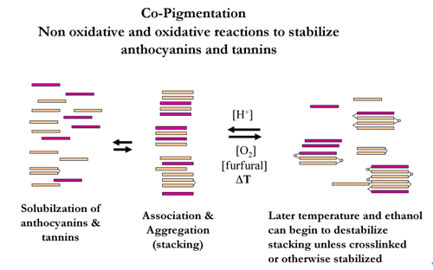
Wine Color
Caused by wine pigments
Most notably the anthocyanins
Color of anthocyanins is affected by:
  pH
  Binding to SO2
  Co-pigments

Slide 45
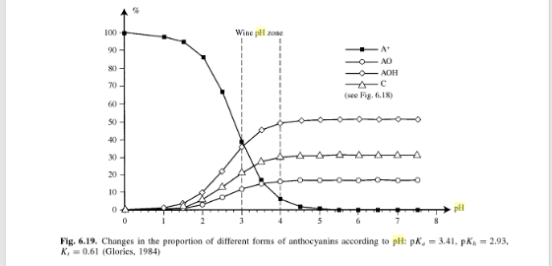
BLUE
COLORLESS
RED
YELLOW

Slide 46
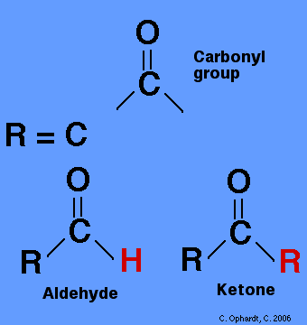
Functions of SO2 in Winemaking
Antimicrobial Agent
  Kills or stops growth
Inhibition of oxidase activities
  Stops PPOs
Antioxidant activity
Binding to carbonyl compounds
  Aldehyde

Slide 47
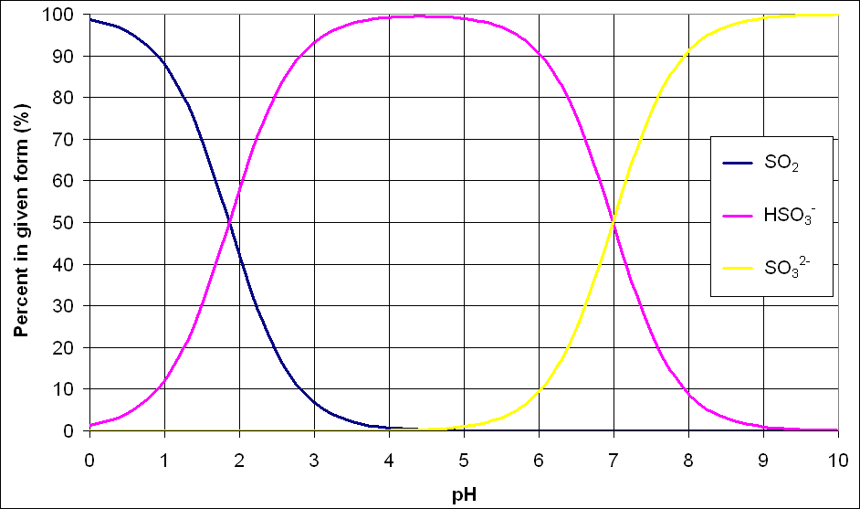
The chemistry of SO2
Sulfur dioxide is a gas at room temperature
In aqueous solution a pH dependent equilibrium is established
SO₂: molecular sulfur dioxide – ACTIVE FORM
HSO₃⁻: bisulfite (anion)
SO₃²⁻: sulfite (dianion)
At wine pH, the bisulfite ion predominates
Almost no dianion form at wine pH
Low levels of molecular form present at wine pH
pKa=1.81
pKa=7.20
H₂0 + SO₂
HSO₃⁻ + H⁺
SO₃²⁻ + H⁺

Slide 48
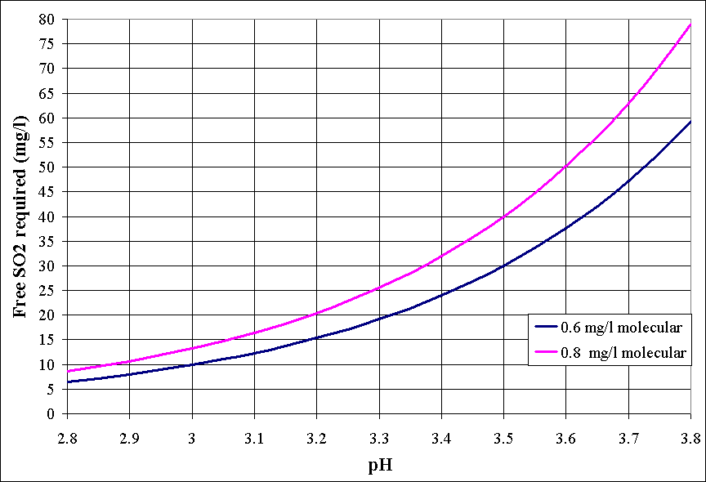
How much SO2 do you need?

Slide 49
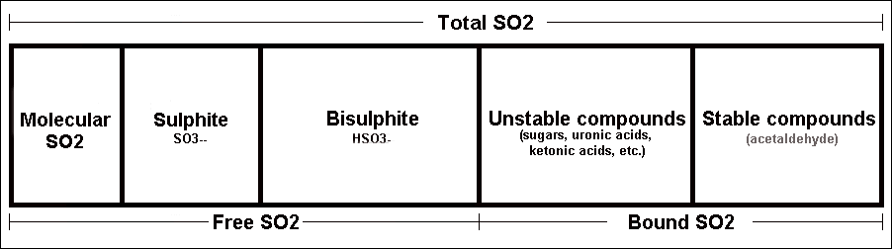
Forms of SO2 in juice and wine
Not all SO2 added to juice or wine remains free in its various forms
Chemicals in juice and wine form reversible associations with SO2
The “bound” SO2 is no longer active but may be released if conditions change

Slide 50
Roles of SO₂
Antimicrobial
  Molecular SO₂ can permeate into cells and kill them
Anti-oxidasic
  Inhibits PPO Enzymes
Anti-oxidant
  Dianion form (sulfite) is what reacts with oxygen, at wine pH almost none exists
  However, molecular SO₂ binds strongly to H₂O₂ to create sulfuric acid
  H₂O₂ arises from non-enzymatic oxidation of phenolics
  Boulton “Only significant contribution of SO₂ as an antioxidant in wine appears to be in reaction with H₂O₂”

Slide 51
Ascorbic Acid and SO₂
Ascorbic Acid reacts readily with oxygen
Upon oxidation it forms hydrogen peroxide
This binds rapidly to any free molecular SO₂
Free SO₂ will be depleted by peroxide, leaving wine with no protection
If free SO₂ is insufficient, peroxide will oxidize wine
Add SO₂ to wine when adding ascorbic acid

Slide 52
Sulfur dioxide (so2)
Strong bronchial constrictor
Threshold 10 ppm in air, 15-40 ppm in wine
Metallic (tin), harsh character
Pungent aroma, sharpness/pain in nose
Control sample has been spiked with KMBS
Smell and taste the control wine
Smell and taste the spiked sample
Are they different? How?
Increase of Total SO2 by 0.114 g/L (114 ppm)

Slide 53
VOLAtile acidity

Slide 54
Volatile Acidity
AKA VA
Combination of acetic acid and ethyl acetate
Typically found at 90/10 – 99/1% combo in wine
They have a synergistic effect

Slide 55
Acetic Acid
Volatile acid produced by yeast
Threshold between 0.6 – 0.9 g/L
Vinegar smell
Makes acids and tannins sharper
Can be masked by sugar and alcohol
Usual source is acetobacter

Slide 56
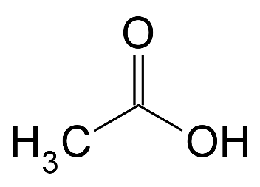
Acetic Acid
  Made by Gluconobacter/Acetobacter
  Needs O2
  Topping up important.. from tasting, evaporation, wood adsorption
  Acrid smell/taste
  Can be controlled via pH, SO2 and temperature
  Try to minimize the bacteria throughout winemaking

Slide 57
Ethyl Acetate
Ester produced by yeast
Threshold 10 ppm
<50 ppm complexing
>150 ppm
  Nail polish
  Glue
Spoilage yeasts and bacteria are the source

Slide 58
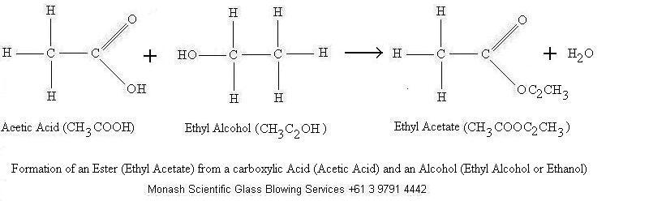
Ethyl Acetate
  Acetic Acid reacts with Ethanol to form Ethyl Acetate
  Has a hot smell
  Glue like or solvent

Slide 59
Volatile Acidity
  Analysis wise is reported as acetic acid equivalents
  Composed of about 90% Acetic Acid and 10% Ethyl Acetate
  The combo of the two is more potent than the single compounds
  Can be blended away
  VA Reduction via RO is possible

Slide 60
Volatile acidity
Acetic Acid
  Threshold between 0.6 – 0.9 g/L
  Vinegar smell
  Makes acids and tannins sharper
  Can be masked by sugar and alcohol
Ethyl Acetate
  Threshold 10 ppm
  <50 ppm complexing
  >150 ppm
  Nail polish
  Glue
Control sample has been spiked with Acetic Acid + Ethyl Acetate
Smell and taste the control wine
Smell and taste the spiked sample
Are they different? How?
Increase of Volatile Acidity by 0.7 g/L

Slide 61
Oxidation

Slide 62
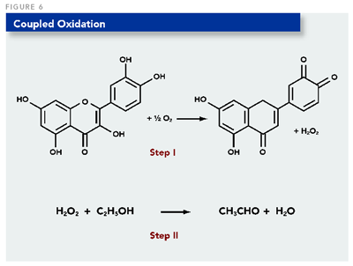
Oxidation
Oxidized character on its own is rare
  Usually combined with other taint compounds
Caused by oxygen reacting with various compounds in wine
Can occur all throughout vinification
Can mimic this with Hydrogen Peroxide

Slide 63
oxidation
Dulls the wine aroma
Straw/Hay
Color darkened
Control sample has been spiked with Hydrogen Peroxide
Smell and taste the control wine
Smell and taste the spiked sample
Are they different? How?
Chemically oxidized to excess

Slide 64
Thank you
Wine provided by Peltier Winery
SHW members for pouring
SHW members for letting me gab

